Slide 1


UNREAL ENGINE 4 Lessons Learnt and What’s to Come
James Golding Lead Programmer, Epic Games
@EpicJamesG

Slide 2
What is this talk about?
What we did for launch
What we did since launch
What we learnt
What we are doing next

Slide 3

What is UE4 Subscription?
Launched 4.0 on March 19th at GDC
$19 (~£13) a month + 5% royalty
‘We succeed when you succeed’
If you cancel, keep using what you have
Full source code
Regular releases

Slide 4
What we did for launch

Slide 5

Change In Culture
Openness and honesty
Don’t ‘nickel and dime’ developers
Collaboration between teams
Docs, Engineering, Support, Marketing
Put everyone in one room. Cosy!

Slide 6
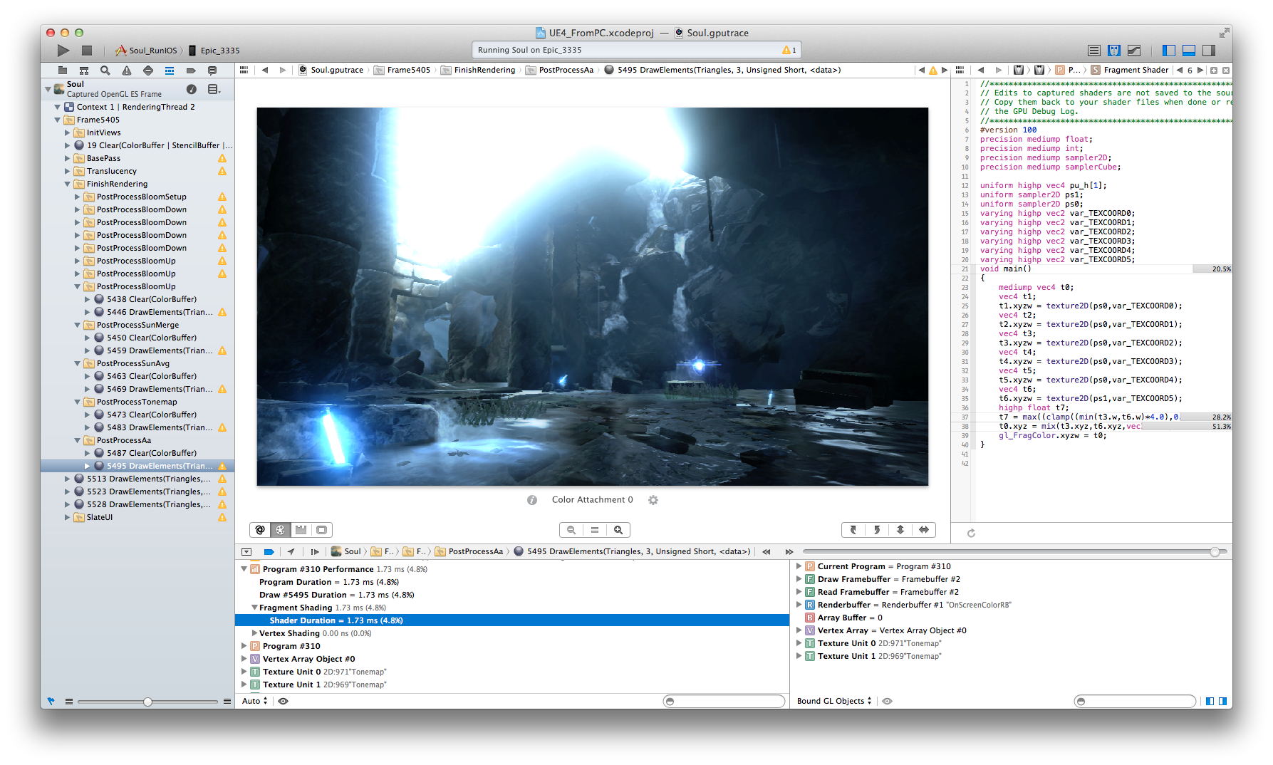
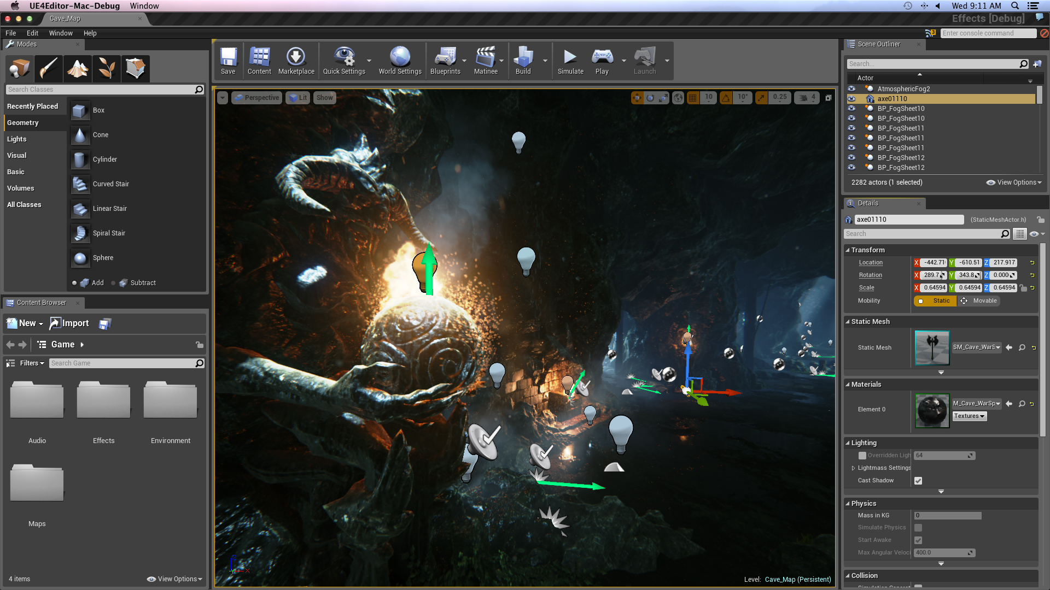

Platform: Mac
Xcode workflow
Still improving
Mac tools for the first time!
Wrote our own UI toolkit (Slate)
OpenGL 4.1
Missing many features we use in DX11/GL 4.3

Slide 7


Platform: Mobile
Treating Android and iOS as equals
Uses same art pipeline as desktop
Node-based material editor
Forward renderer
Different from deferred on desktop
Static lighting
HW getting fast enough for deferred!
Improving performance on lower-end devices

Slide 8
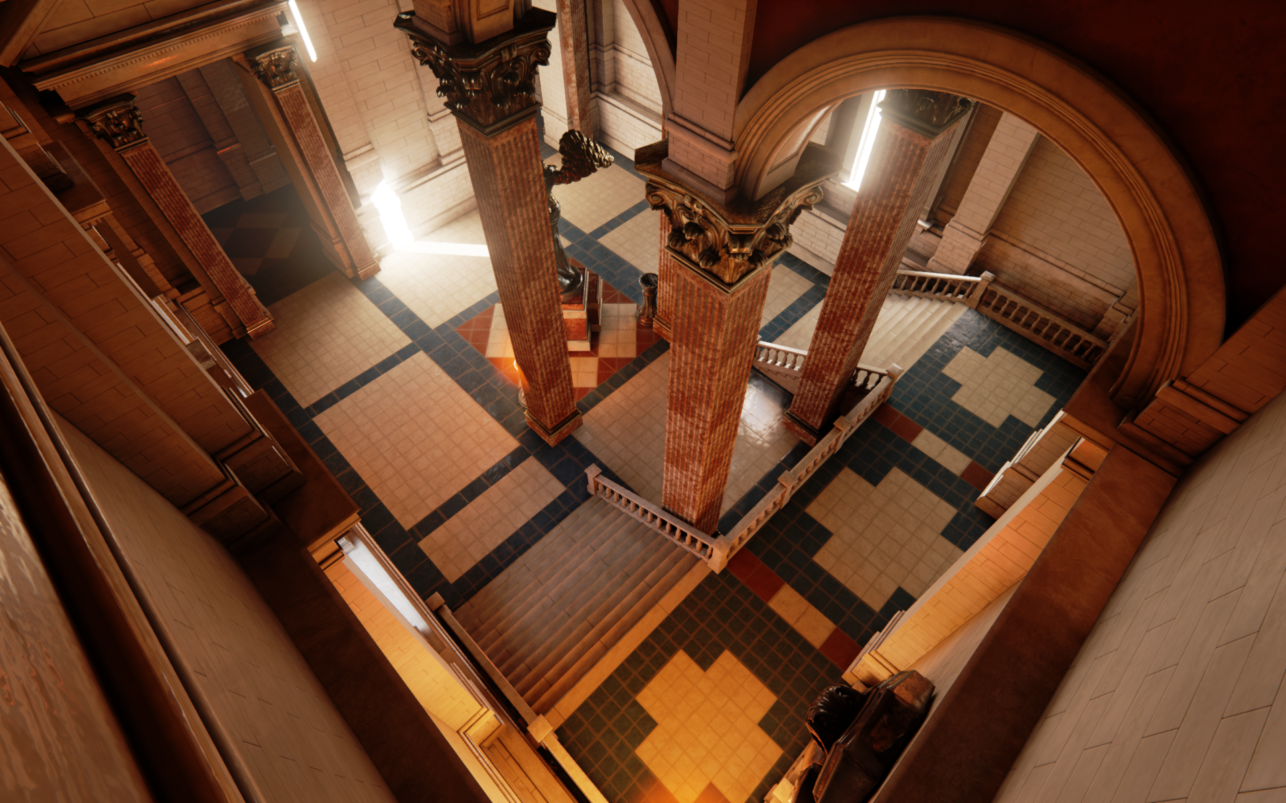
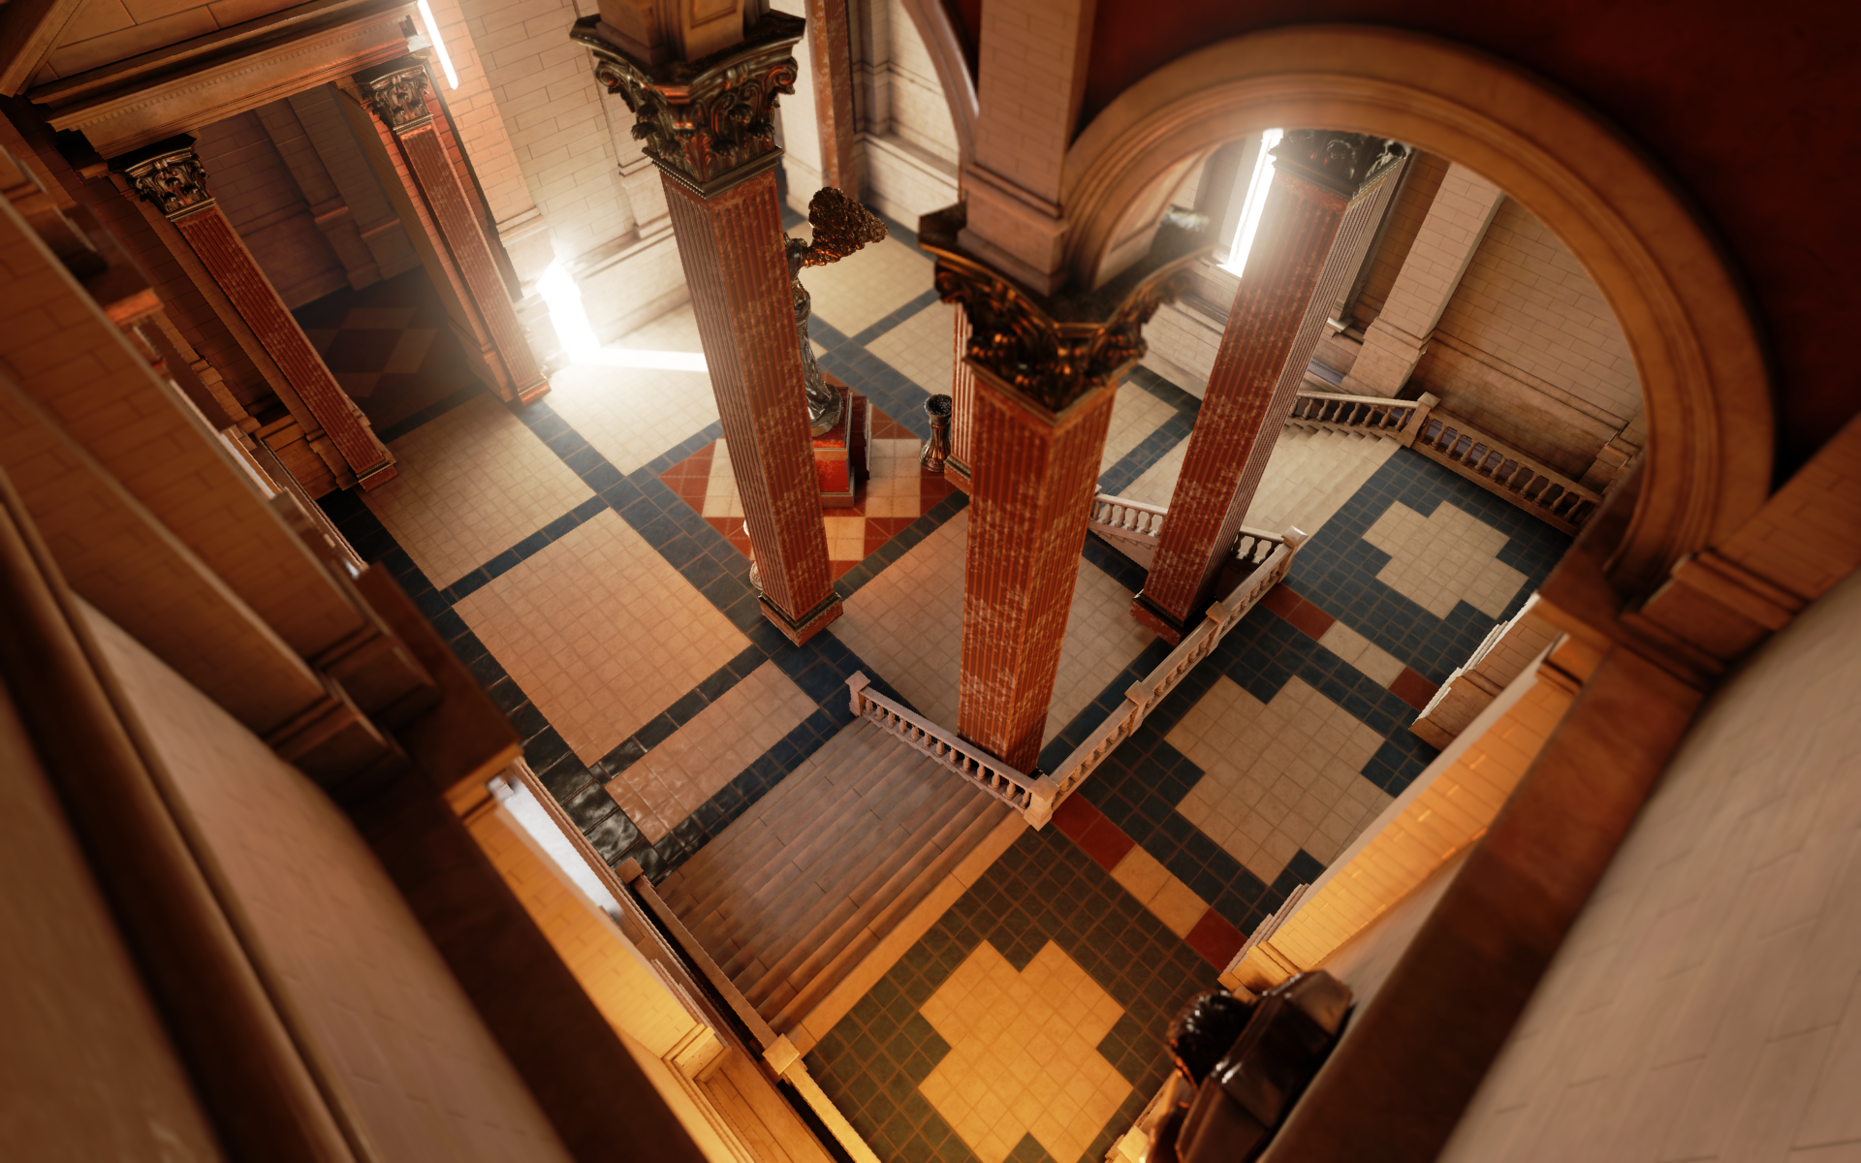
Platform: Mobile
Desktop
Mobile

Slide 9
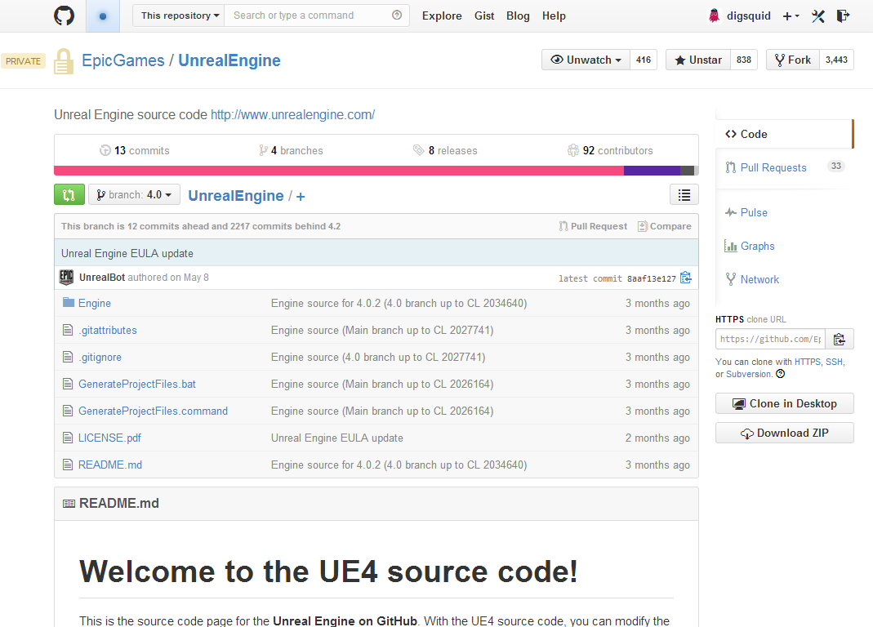
Source Code
Use GitHub to distribute source code
Hosting is $20/month on Mike’s credit card!
Allow users to submit ‘pull requests’
Features
Fixes
Optimizations
Dev team went on a Git crash course

Slide 10
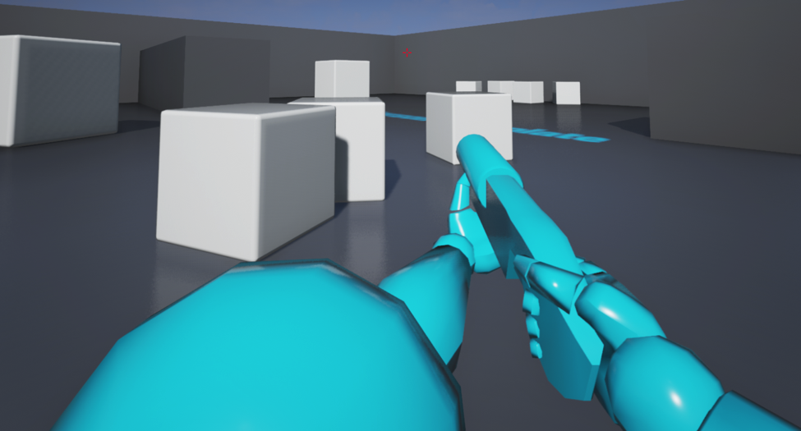
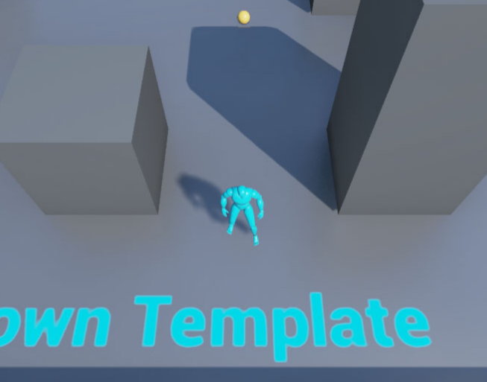
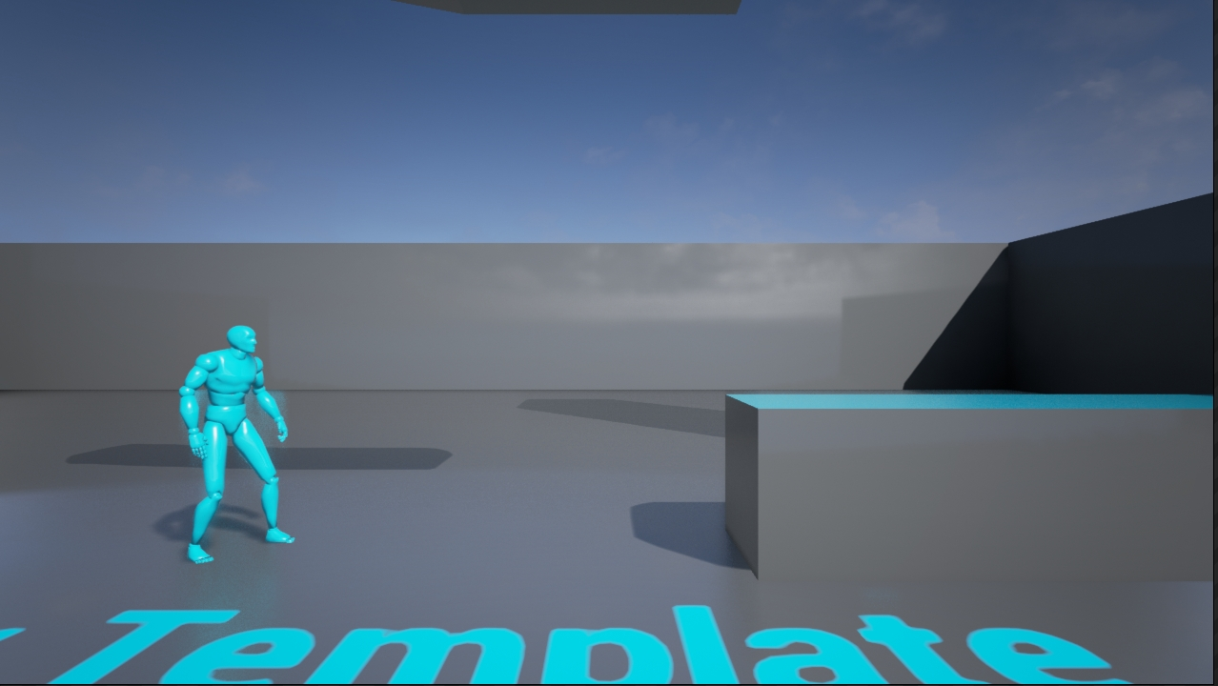
Templates
Minimal examples of different genres
First-person
Third-person
Top down
Sidescroller
Blueprint and C++ versions
Valuable exercise
Modify UE4 to simplify work needed
Ensure it’s possible in Blueprint

Slide 11
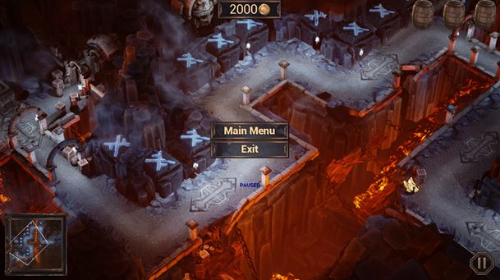
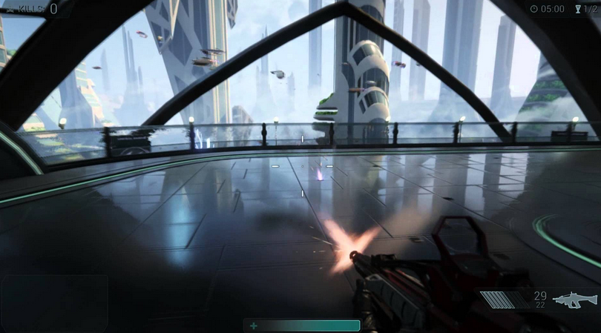
Sample Games
Different genres & platforms
Demonstrate more game systems
Gameplay, HUD, menu, effects, audio
Devs can use content
More complex than templates
Combination of C++ and Blueprints
Hard to balance ‘pretty’ vs. ‘educational’
Making a fun, good-looking game doesn’t usually lead to clean code!

Slide 12





Backend
Patcher/launcher
Team has grown substantially
Account management
Single login for forums, website, etc.
GitHub integration
Payment processing
Added PayPal recently
Fewer issues at launch than feared

Slide 13
Delete Code!
Deleted systems from UE3 that are too ‘game specific’
Inventory, weapons, jump pads…
These will never work for all games
Would rather make good tutorials and samples
Many discussions about damage, we kept it in the end
Remove options where possible
UE3 had many ‘special case’ flags that made it hard to use
Removing a flag is 100x harder than adding it!
Need to keep options required for performance (e.g. static vs. dynamic)

Slide 14

Closed Beta
Code name ‘Rocket’
6 Beta releases to select users
Distribution problems
Compatibility
Usability
Helped create knowledgeable community for public release

Slide 15
What we did since launch

Slide 16
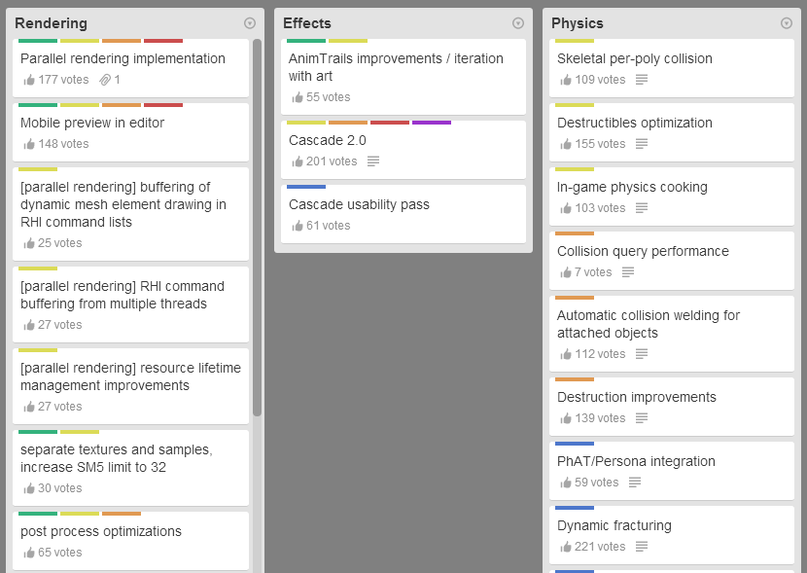
Roadmap
Made our roadmap public
Using Trello at the moment
Top voted features:
UI system (UMG)
RPG sample
Programming docs
Vehicles
Linux editor
Updated monthly
Not a PR exercise, we actually use it!

Slide 17
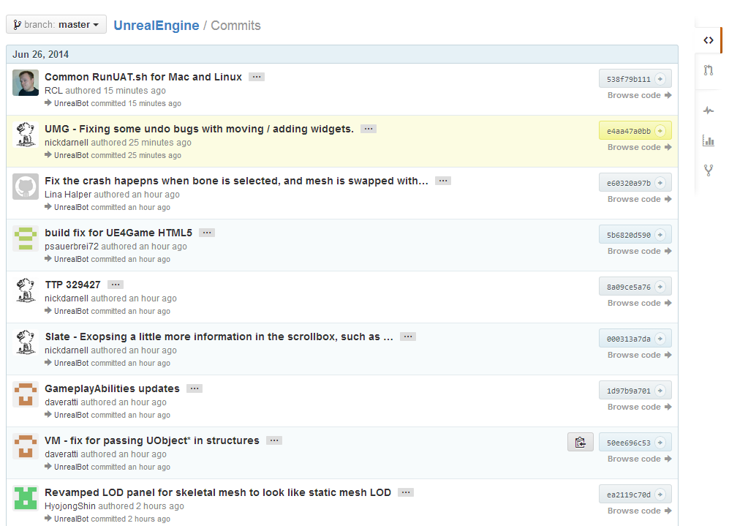
Live GitHub Updates
We still use P4 internally
Added script to ‘push’ checkins to GitHub
~2 minute delay
Great info for devs
View/integrate specific changes
Track feature progress

Slide 18

Unreal Tournament
Community driven development
Hosted on GitHub
Encourage contributions
Levels
Movement prototypes
Weapons
Models
Huge experiment for us!
How to make decisions with so much feedback

Slide 19


Platform: Xbox One and PS4
Added support in 4.1
No additional platform fees
Working on more features
Multi-threaded rendering
Improved Morpheus support
Shader optimizations
ShooterGame through cert

Slide 20


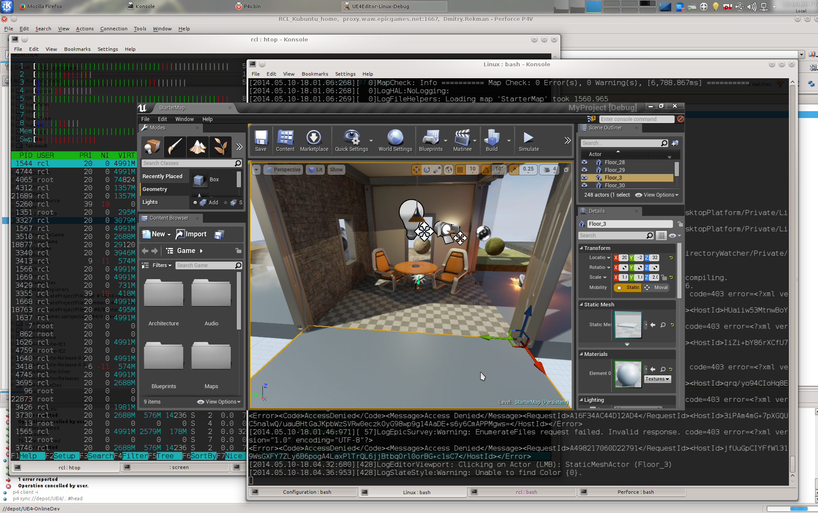
Platform: Linux & SteamOS
4.0 had dedicated server support
4.1 added client support
Using Open GL
Community effort for Linux tools!
#ue4linux IRC channel
Taking changes via GitHub

Slide 21

Platform: HTML5
Craziest platform
UE4 on your browser
C++ code is converted to JavaScript (using Emscripten)
Which is then run using the asm.js extension
Runs at 50% native speed
Render using WebGL
Uses the browser and might end up using D3D under the hood

Slide 22
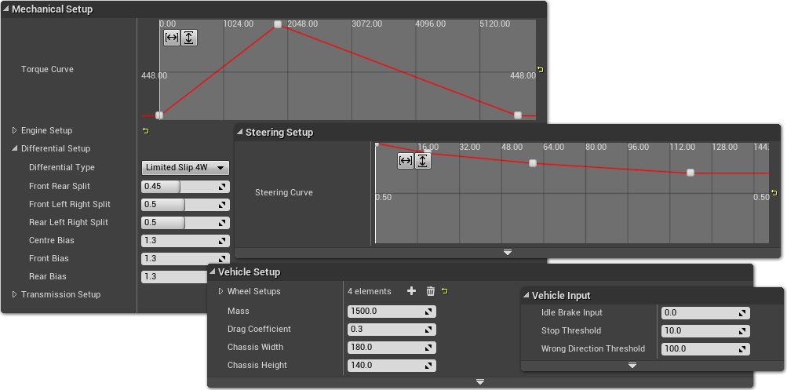
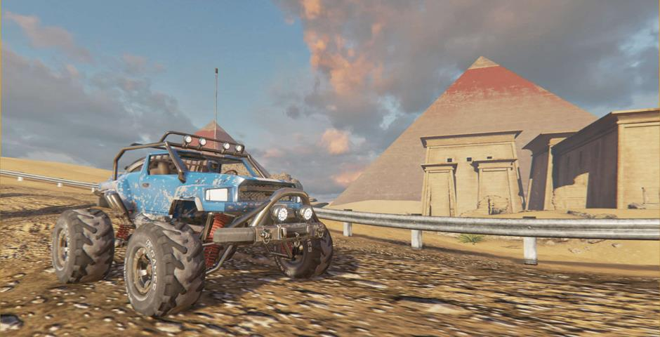
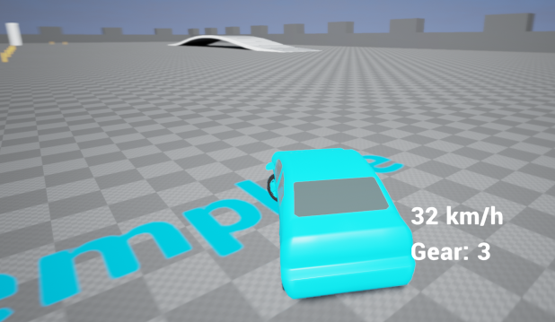
Vehicle Support
Part of 4.2 release
Using PhysX vehicle library
Limited slip diff
Automatic gearbox
Template & sample game

Slide 23

Tappy Chicken
Actually shipped on multiple platforms
iOS, Android, HTML5
More work than we expected!
Made entirely in Blueprints by an artist
Including ads, achievements, etc.
Released as sample
Keeping it functional as platforms change
Blog about work required

Slide 24
What we learnt

Slide 25
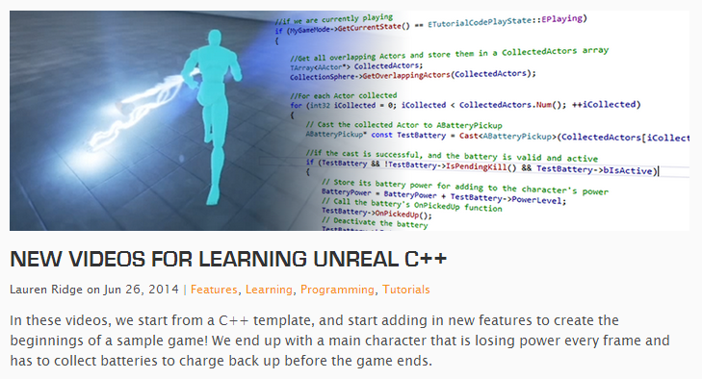
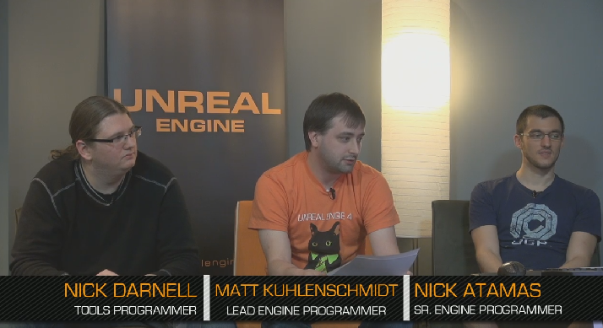


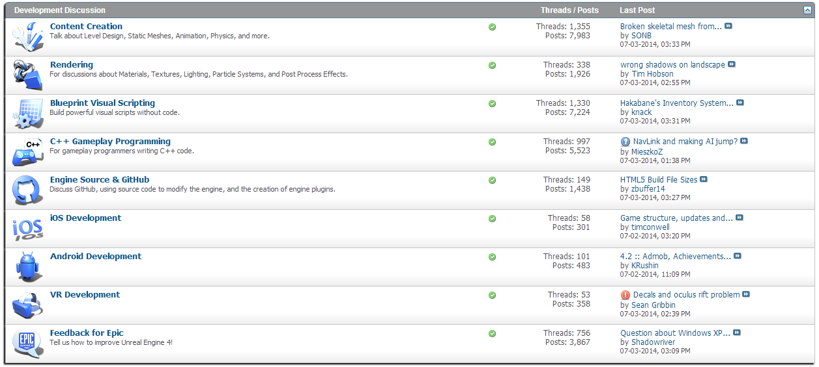
Communcation
Has been going well
Tim Sweeney has good karma on AnswerHub ☺
Most people patient and obliging
Especially when they’re being listened to
‘One good deed a day’
Team at Epic encouraged to make at least one answer/post each day
Programmers on camera!
Twitter very active

Slide 26

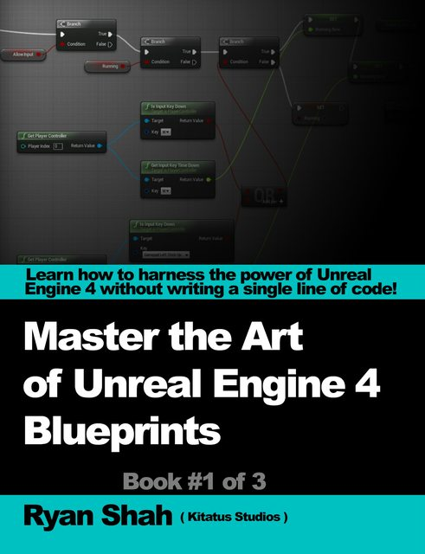
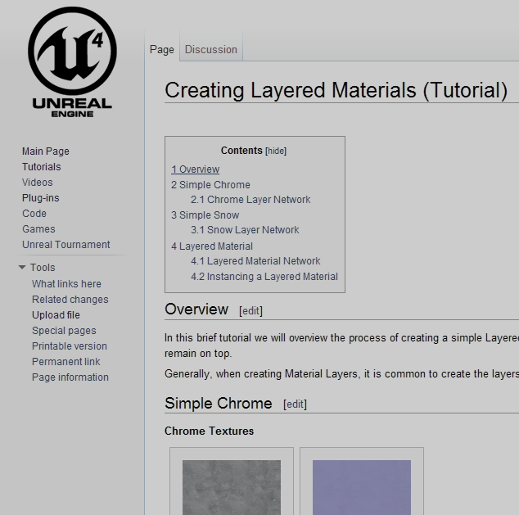
Community Support
160+ video tutorials on YouTube
140+ tutorials on our wiki
Free book series about Blueprints
Community IRC channels
Plugins, content packs, templates...
Positive, constructive forums!
#unrealengine

Slide 27

Source Availability
More successful than expected!
Lots of GitHub activity
3481 forks
266 code submissions
Still improving integration process
Assigning submissions to UE4 team

Slide 28
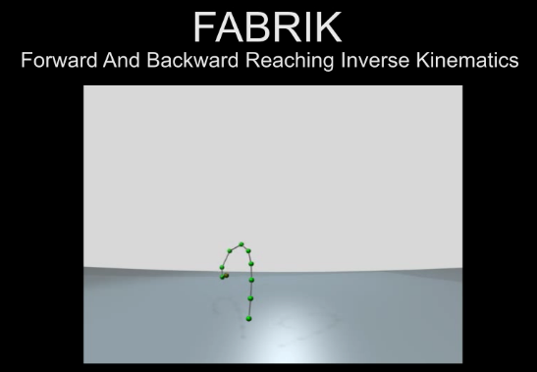
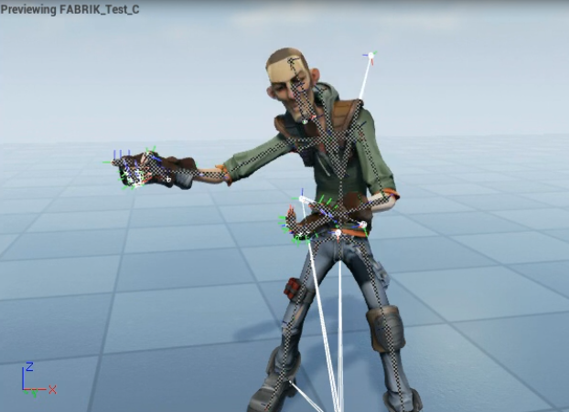
Community: FABRIK Solver
Research we had not seen
Fast, stable, multi-bone
Iteration with one of our animation programmers
Now standard UE4 feature

Slide 29

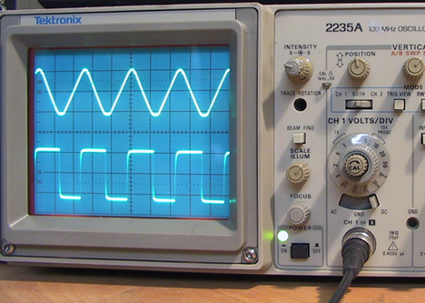
Community: Code Analysis
PVS-Studio developer ran it on our entire codebase
Made detailed blog post on findings
We fixed them all for the next release

Slide 30
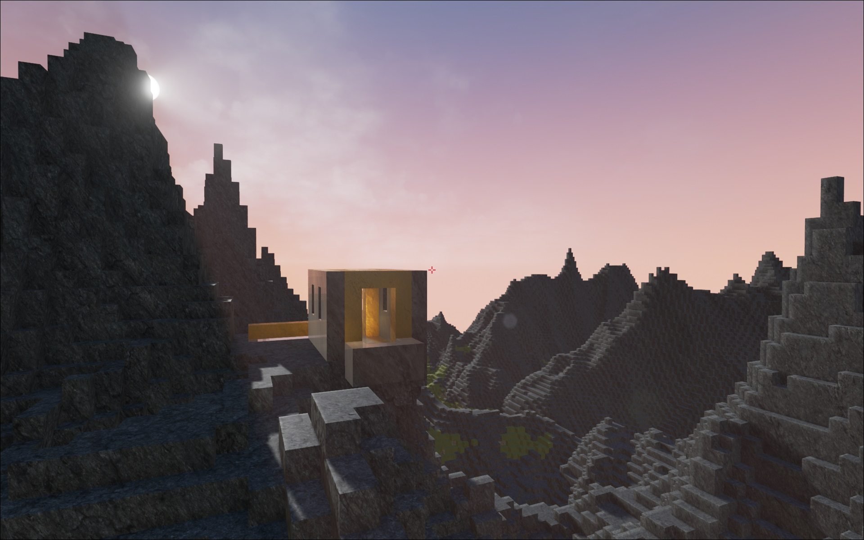
Community: BrickGame
Minecraft-style
Uses LPV feature (Dynamic GI)
Custom geometry rendering
Source released on GitHub

Slide 31
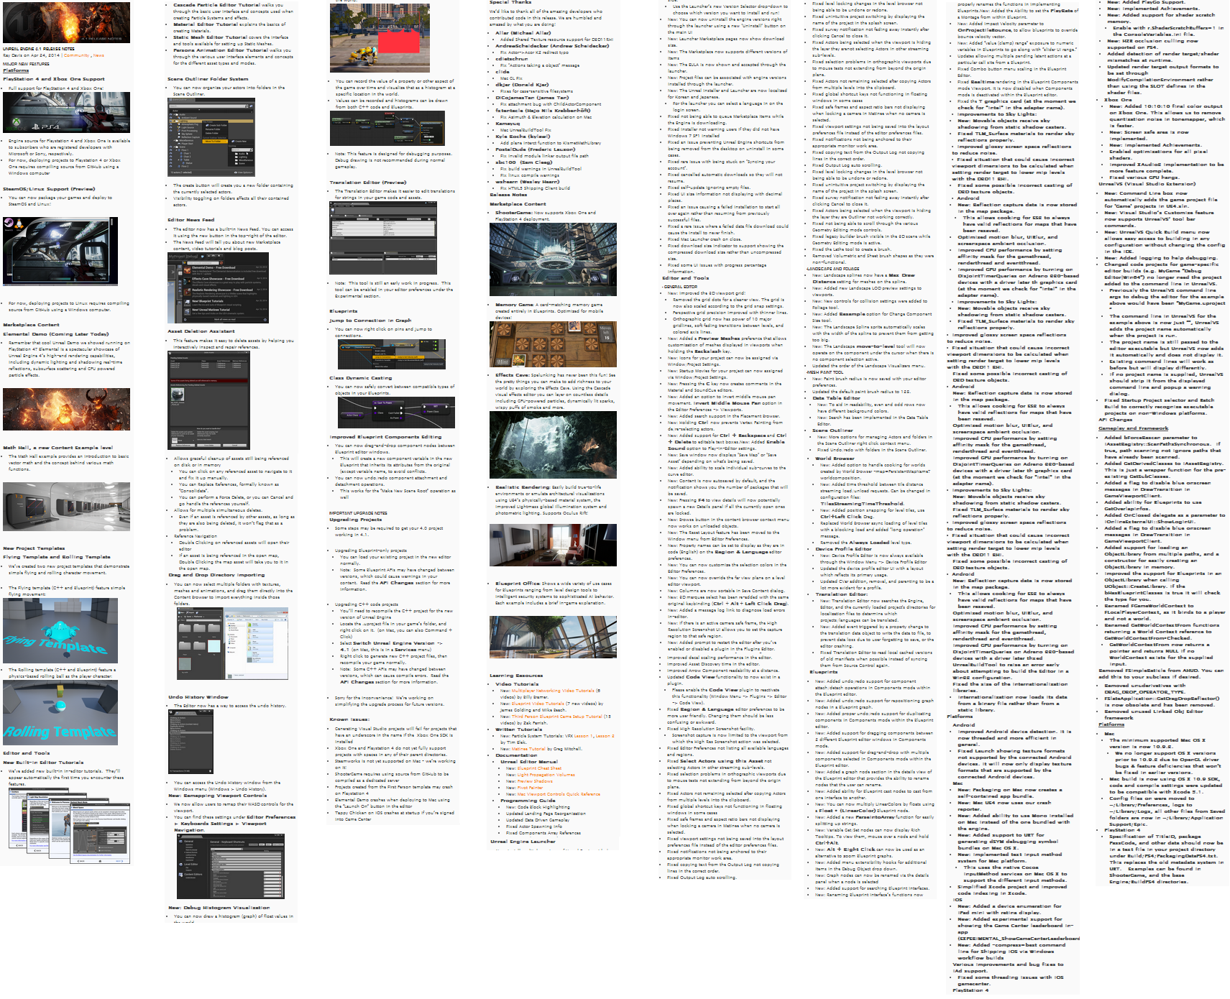
Regular Releases
4.1 Release Notes
Plan was for monthly releases
Concern about size of each release
In practice, a month of work is a lot of changes!
Four weeks is a bit short in practice
Testing/fixing takes time
Now aiming for 5-6 weeks
Hot-fixes for major issues

Slide 32

Laptops
People like laptops!
Not having a good experience with UE4
Heat, battery life, fan noise, performance
Several improvements in 4.3
Automatically scale settings
Reduce CPU and GPU load

Slide 33
C++
Supporting only C++ and Blueprints was a little contentious
Tim Sweeney discussed decision on forums
Adding ability to support other scripting languages
Using existing reflection that Blueprints use
Lua is our example
Other teams looking into C# support

Slide 34

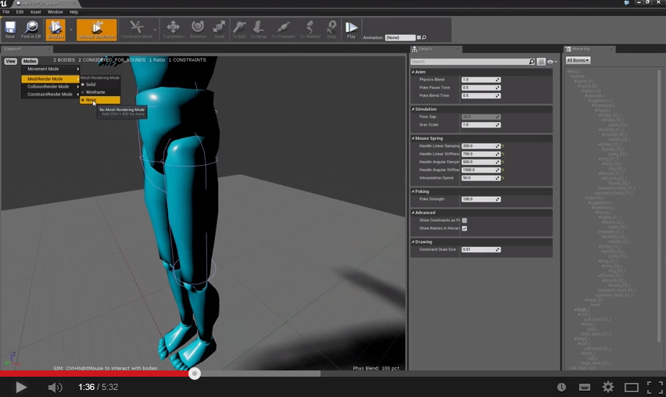
Documentation
Hard to keep up!
Engine changing rapidly
Many users like video tutorials
Encouraged our teams to make them
Sharing doc plans on roadmap
Responding to feedback

Slide 35
What we are doing next

Slide 36
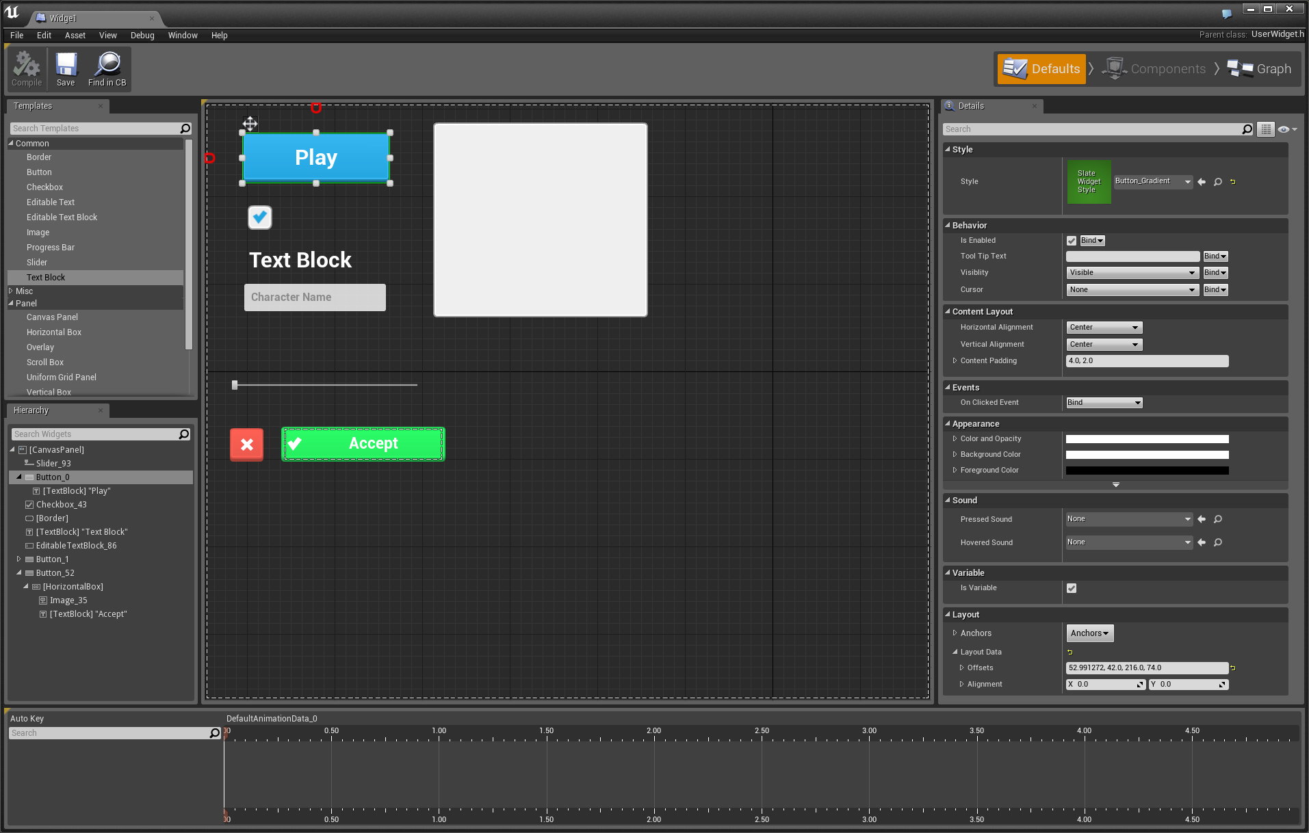
Unreal Motion Graphics
Feedback that HUD/menus are hard to build
UMG is our visual UI Tool
Built on top of Slate
Drag & drop widgets
Bind events using Blueprints
Animation support

Slide 37
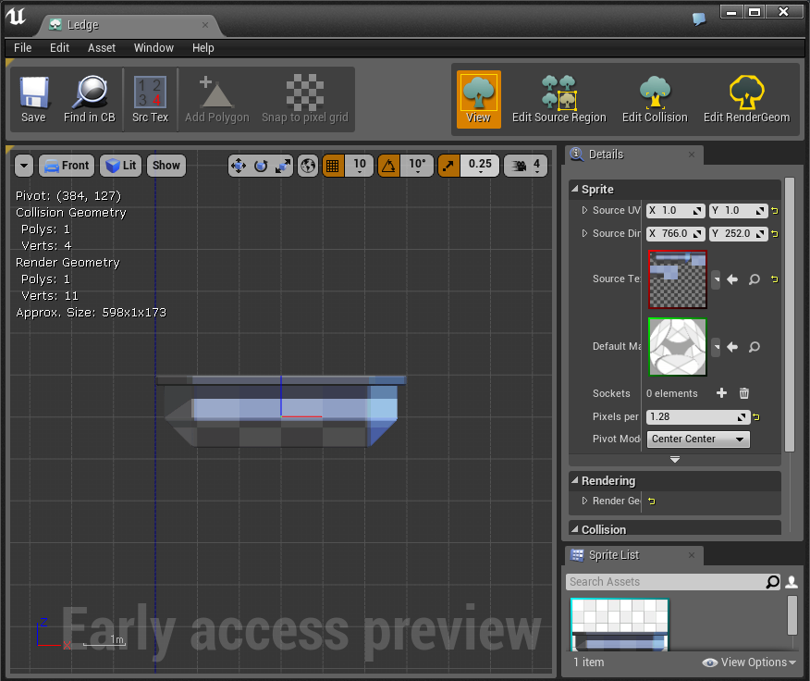
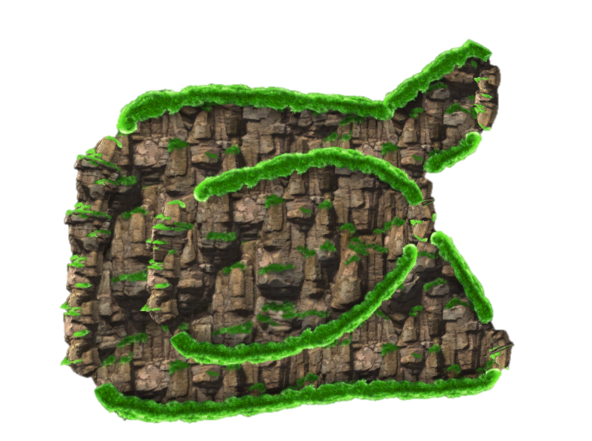
Paper2D
2D support for UE4
Sprites
Flipbooks
Tile maps
Splines/2D terrain
Box2D physics

Slide 38

New User Experience
UE4 is a large engine with a lot to learn!
Still working hard on documentation
Gameplay framework
Pawn, PlayerController, GameMode…
Provides a lot of help and structure
Requires learning new concepts
More links between editor and docs
More in-editor tutorials
Improve tools
More intuitive, less intimidating

Slide 39
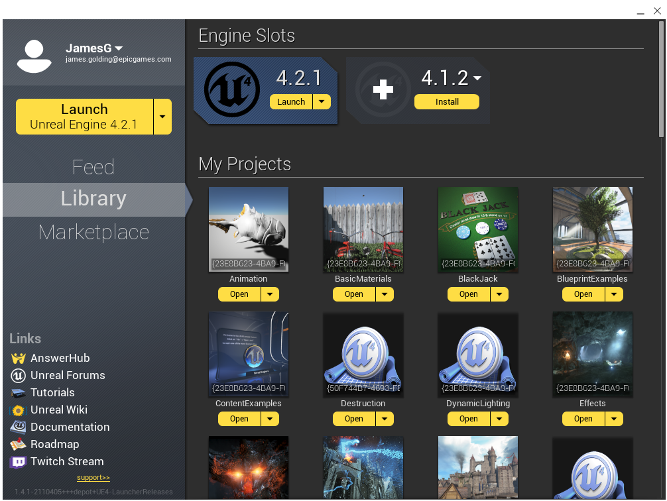
Launcher
Make it a more valuable tool
Better support for GitHub users
Distribute binary requirements
Add social and collaboration tools
Help small teams work together

Slide 40
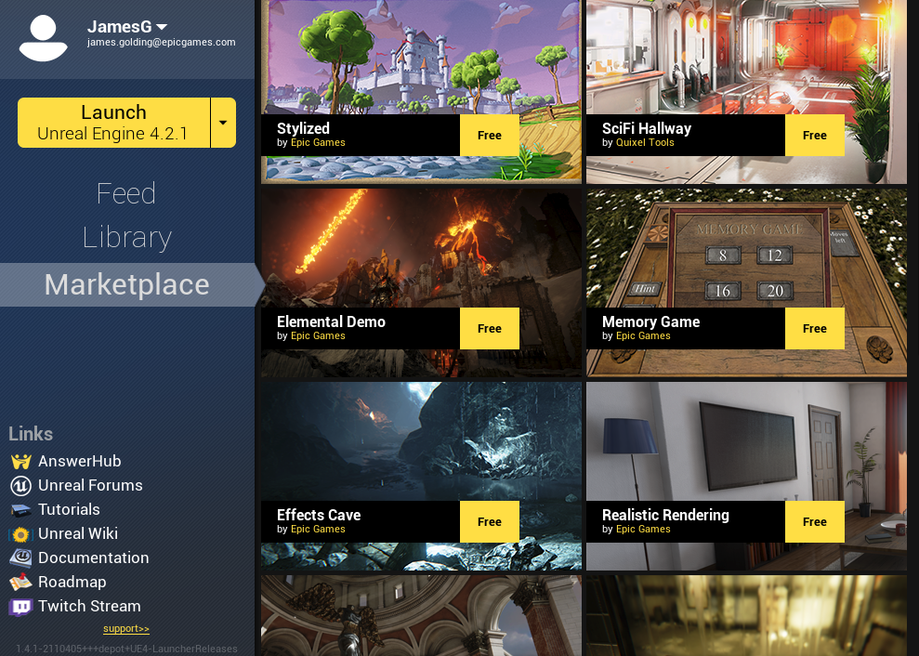
Marketplace
Currently only Epic content
Will evolve over time
Plan to sell community content
Plugins
Assets
Samples
Tutorials
Templates

Slide 41

Experimental Builds
Many users eager for ‘bleeding edge’ builds
Get a critical bug fix
Give feedback on features
Plan to allow users to download daily ‘unstable builds’
Have passed internal smoke tests
What our internal teams use
Important to set proper expectations!

Slide 42
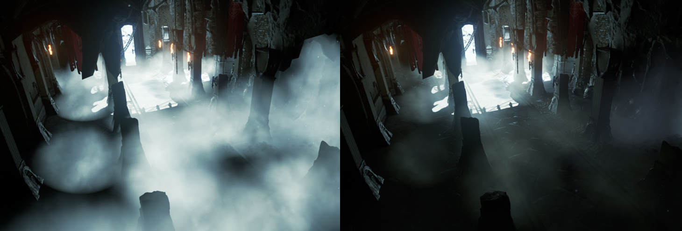
Rendering Features
Lit translucency

Slide 43

Rendering Features
Clear coat shading model

Slide 44
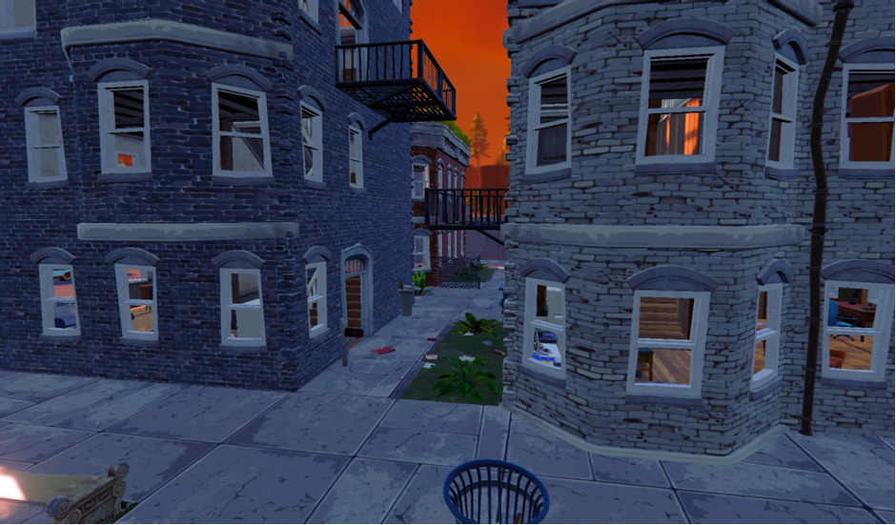
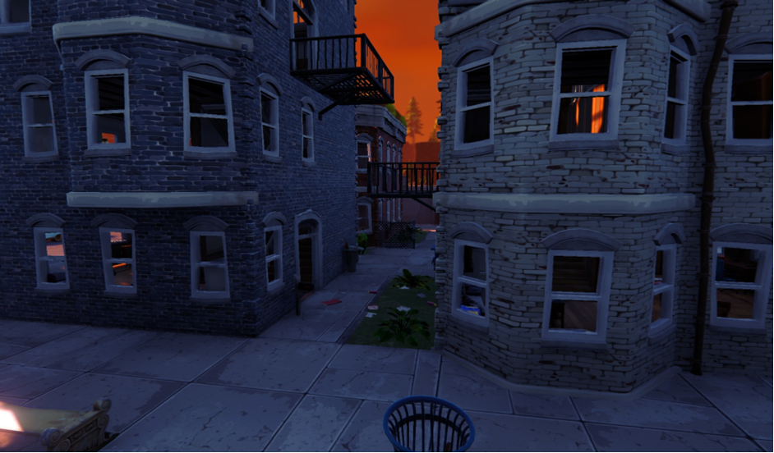
Rendering Features
Large scale dynamic ambient occlusion

Slide 45
Thank you!
Any questions?
PS. We are hiring! epicgames.com/careers

