Slide 1

UE4 VR
Niklas Smedberg
Senior Engine Programmer, Epic Games

Slide 2
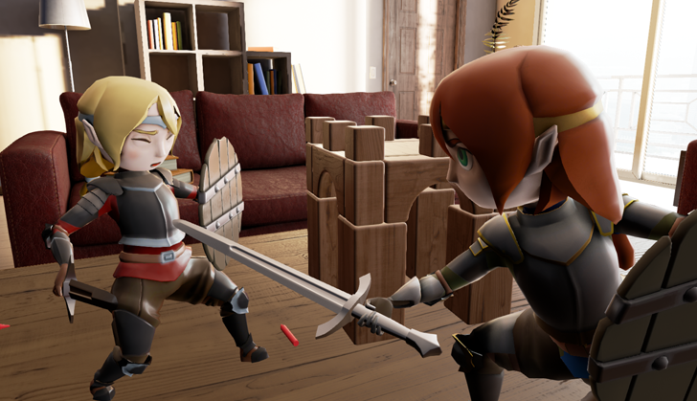
GDC 2014: “Couch Knights”

Slide 3
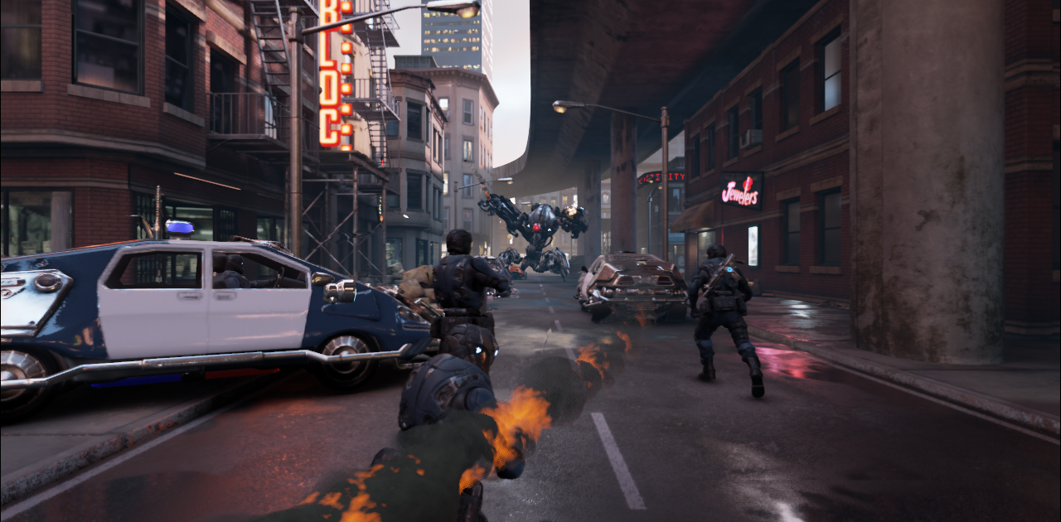
Oculus Connect 2014: “Showdown”

Slide 4
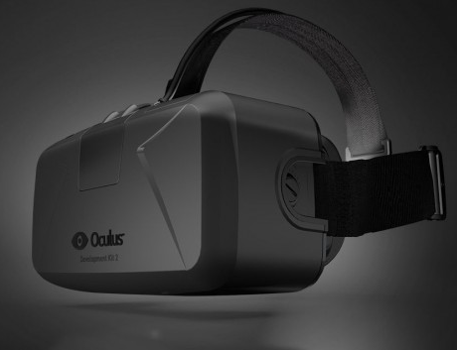
Oculus Rift DK 2
Development Kit 2
1920x1080 display
HDMI to desktop PC

Slide 5
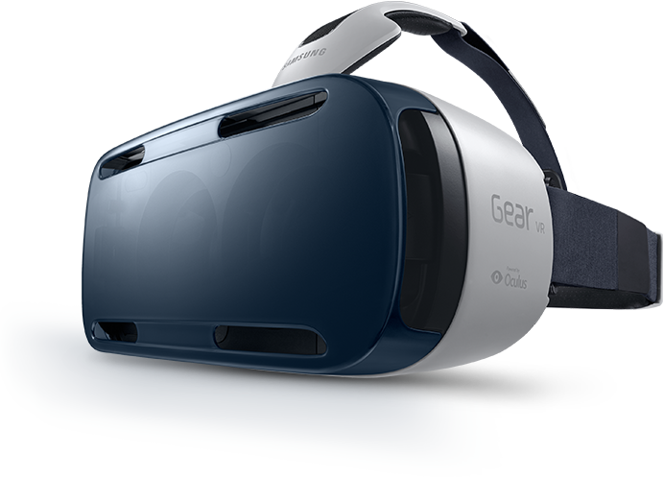
Samsung Gear VR
Gear VR Headset
Galaxy Note 4 (2560x1440)
Occulus VR SDK

Slide 6
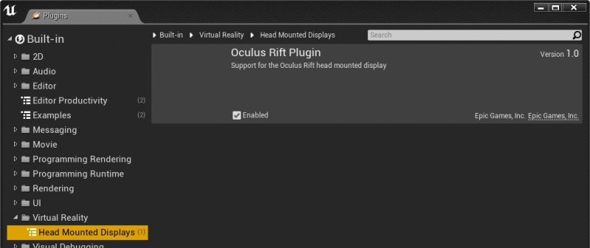
UE4 VR Project Setup
Enable the Oculus Rift plugin:

Slide 7
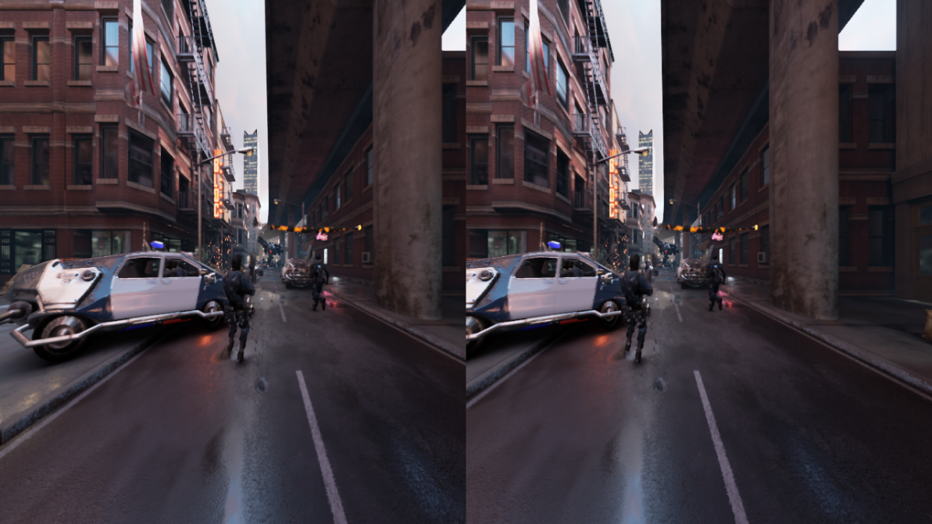
Stereoscopic Rendering
The frame is rendered twice, once per eye

Slide 8
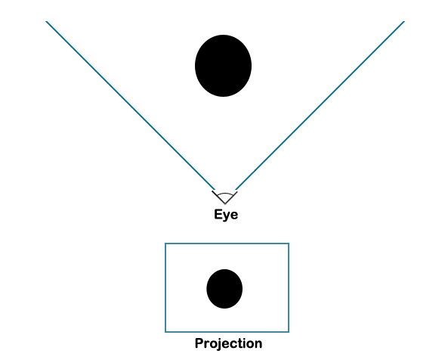
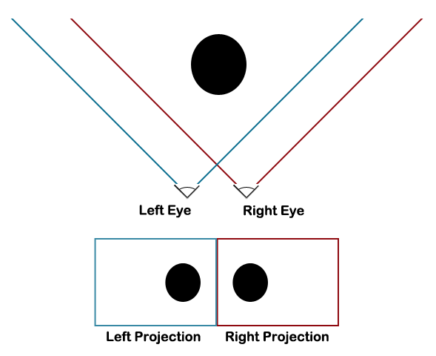
Intrapupillary Distance (IPD)
Differs from person to person
GearVR supports 55-71 mm

Slide 9
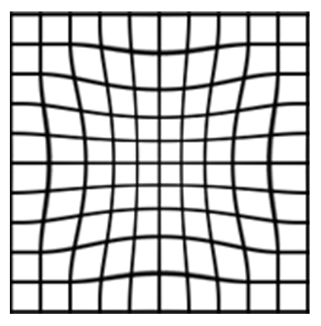
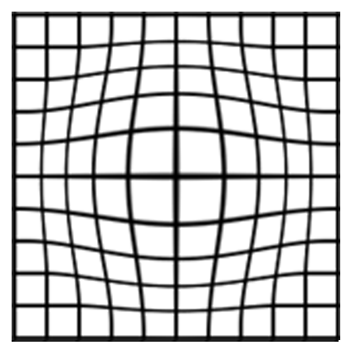
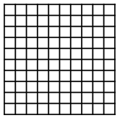
Lens Distortion
VR optics distort/warp the image for each eye
Must be compensated for in post-process:
+
=
Lens distortion
Compensation
End-user result

Slide 10
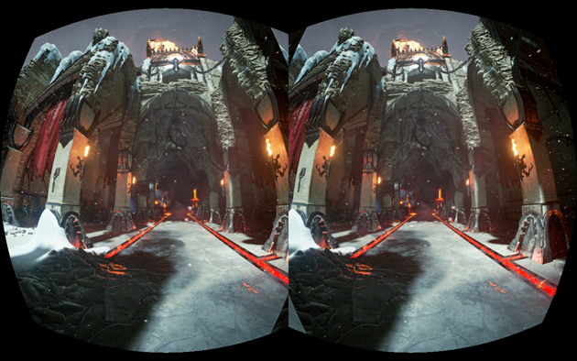
Lens Distortion
On GearVR, the Oculus SDK does this automatically (“time-warp”)

Slide 11
VR Tips
Minimize latency!
DK2: 60, 72 or 75 FPS
GearVR: 30 or 60 FPS
Sensors are read twice per frame
Oculus Time-warp takes “last-minute” orientation into account

Slide 12
VR Tips
Use real geometry instead of:
  Normal maps (e.g. surface detail)
  Sprites (e.g. particle effects)
  Billboards (e.g. foliage)
  Flipbook movies (e.g. explosions)
Anti-aliasing:
  Use None, FXAA or hardware MSAA
Minimize number of drawcalls
  VR doubles the drawcall count
Minimize post-process effects
  High frame rate is critical

Slide 13
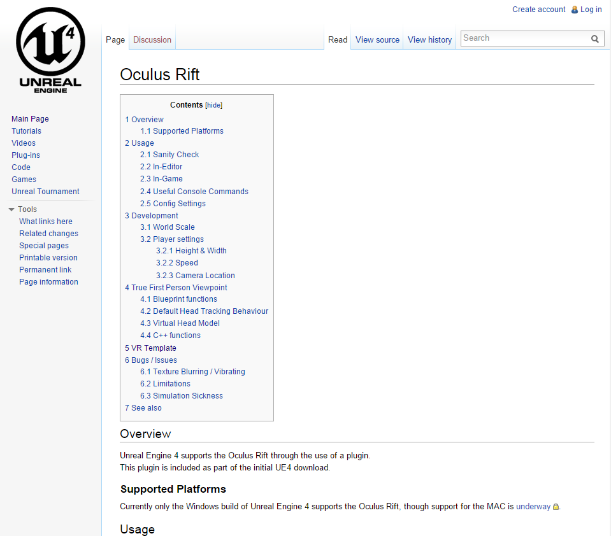
UE4 VR Documentation
UE4 Oculus Rift wiki
  https://wiki.unrealengine.com/Oculus_Rift

Slide 14
UE4 HTML5 Questions?
Documentation, Tutorials and Help at:
AnswerHub:
Engine Documentation:
Official Forums:
Community Wiki:
YouTube Videos:
Community IRC:
Unreal Engine 4 Roadmap
lmgtfy.com/?q=Unreal+engine+Trello+
http://answers.unrealengine.com
http://docs.unrealengine.com
http://forums.unrealengine.com
http://wiki.unrealengine.com
http://www.youtube.com/user/UnrealDevelopmentKit
#unrealengine on FreeNode

