Slide 1
The Slate UI Framework
Architecture & Tools
Gerke Max Preussner
max.preussner@epicgames.com
Notes:
Prepared and presented by Gerke Max Preussner for East Coast MiniDevCon 2014, November 12-13th
Email max.preussner@epicgames.com in case of comments, questions or suggestions or visit our AnswerHub at http://answers.unrealengine.com

Slide 2
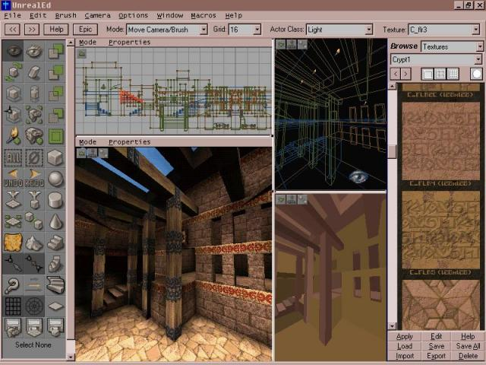
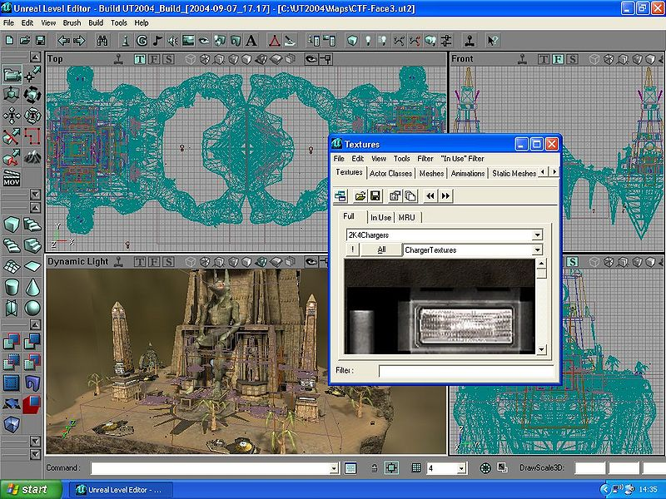
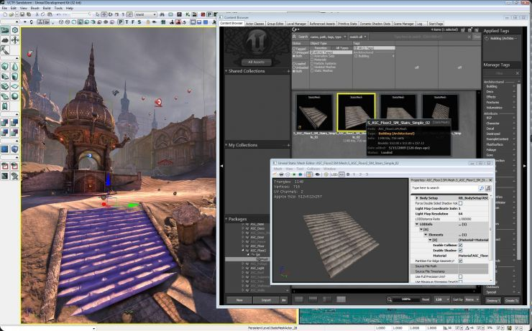
UE1, UE2 and UE3
Notes:
In previous versions of Unreal Engine we used different third party UI frameworks, such as MFC, wxWidgets, Windows Forms and WPF.
All these user interfaces were complicated, cluttered and not very customizable.
In Unreal Engine 4 we have drastically changed how we approach user interfaces.
We want our programs to be more intuitive, customizable, extensible and modern.

Slide 3
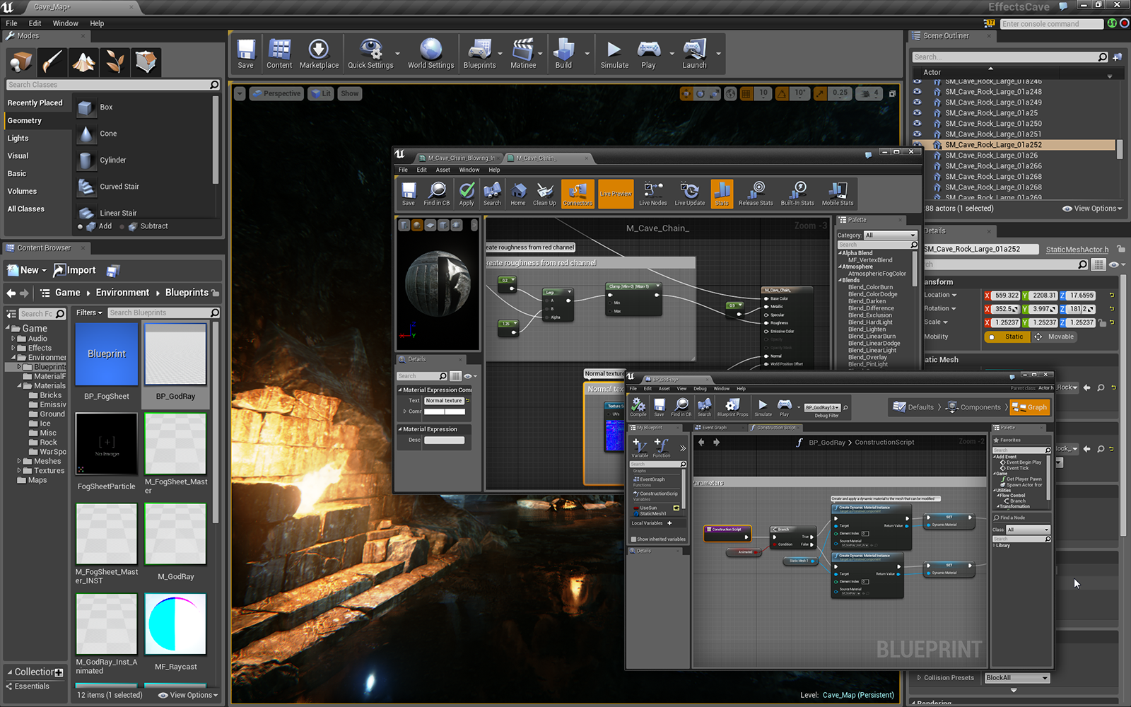
Notes:
The result of this effort is our own UI framework called Slate.
Here you can see a screenshot of the latest Unreal Editor, which is entirely done in Slate.
As you can see, there is now a common look and feel.
Parts of the user interface can be separated and arranged in their own windows.
We also tried to hide a lot the advanced features by default – of course, they are still available though.

Slide 4
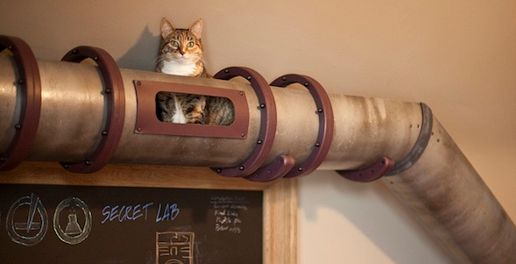
Slate Design & Principles
Overview
Features
Concepts
Tools
Architecture
Written entirely in C++
Platform agnostic (works on mobile and consoles, too!)
SlateCore module provides low-level functionality
Slate module contains library of common UI widgets
Does not require Engine or Editor modules
Current Use Cases
Unreal Editor
Standalone desktop applications
Mobile applications
In-game UI
Notes:
Slate is written entirely in C++ and runs on all platforms supported by Unreal Engine 4.
We used it for the Unreal Editor, standalone desktop applications and tools, as well mobile apps.
It can also be used for in-game UI, but I will talk about that in the second part of this presentation.
Slate used to be just one C++ module, but we recently split it into two, and we may split up further in the near future.

Slide 5
Slate Design & Principles
Overview
Features
Concepts
Tools
Styling
Customize the visual appearance of your UI
Images (PNGs and Materials), Fonts, Paddings, etc.
Customizable user-driven layouts
Input Handling
Keyboard, mouse, joysticks, touch
Key bindings support
Render Agnostic
Supports both Engine renderer and standalone renderers
Large Widget Library
Layout primitives, text boxes, buttons, images, menus, dialogs, message boxes, navigation, notifications, dock tabs, list views, sliders, spinners, etc.
Notes:
The appearance of widgets can be styled with a C++ based style system.
We are currently working on making it better as part of UMG.
The core of Slate takes care of all user input and translates it into events that your application can consume.
Slate can render its UI with the Engine and without.
Of course, Slate also comes with a large library of common UI widgets.

Slide 6
Slate Design & Principles
Overview
Features
Concepts
Tools
Declarative Syntax
Set of macros for declaring widget attributes
Avoids layers of indirection
Composition
Compose entire widget hierarchies in a few lines of code
Uses fluent syntax for ease of use
Preferred over widget inheritance
Any child slot can contain any other widget type
Makes it very easy to rearrange UIs in code
Notes:
The two main concepts in Slate programming are Declarative Syntax and Composition.
Declarative syntax is our way for creating UI widgets in C++ code.
It is very compact and easy to read.
Other UI frameworks heavily rely on widget inheritance, but Slate uses composition instead.

Slide 7
// Example custom button (some details omitted)
class STextButton
: public SCompoundWidget
{
public:
SLATE_BEGIN_ARGS(SMyButton )
{ }
// The label to display on the button.
SLATE_ATTRIBUTE(FText, Text)
// Called when the button is clicked.
SLATE_EVENT(FOnClicked, OnClicked)
SLATE_END_ARGS()
// Construct this button
void Construct( const FArguments& InArgs );
};
// Button implementation (some details omitted)
void STextButton::Construct ( const FArguments& InArgs )
{
ChildSlot
[
SNew(SButton)
.OnClicked(InArgs._OnClicked)
[
SNew(STextBlock)
.Font(FMyStyle::GetFontStyle(“TextButtonFont"))
.Text(InArgs._Text)
.ToolTipText(LOCTEXT(“TextButtonToolTip", “Click Me!"))
];
];
}
Notes:
Here is a simple contrived example of these two concepts.
On the left we declare a new button widget using Slate’s declarative syntax.
The first macro declares an attribute for the button text, and the second macro declares an event delegate for when the button is clicked.
There are several other macros available for declaring other types of widget attributes.
On the right we see the button’s construction code.
Notice that STextButton inherits from SCompoundWidget, one of the fundamental widget types, and we use composition to populate the button’s content.
In this case we are simply wrapping an SButton widget that contains an STextBlock as its content, and we forward any widget arguments that may have been passed in.

Slide 8
Slate Design & Principles
Overview
Features
Concepts
Tools
Widget Gallery
Demonstrates all available Slate widgets and layouts
Widget Inspector
Visually debug and analyze your UI
Can jump directly to widget code in Visual Studio or XCode
UDK Remote
iOS app for simulating touch devices on your PC
Remote server is a plug-in (enabled by default)
Primarily used for game development
Notes:
We also have a couple tools to help you develop your Slate based user interfaces.
Slate comes with a cool visual debugging tool called Widget Inspector – I will demo it shortly.
There is also an app for iOS that allows you to simulate touch input while developing your game or application on a desktop PC.

Slide 9
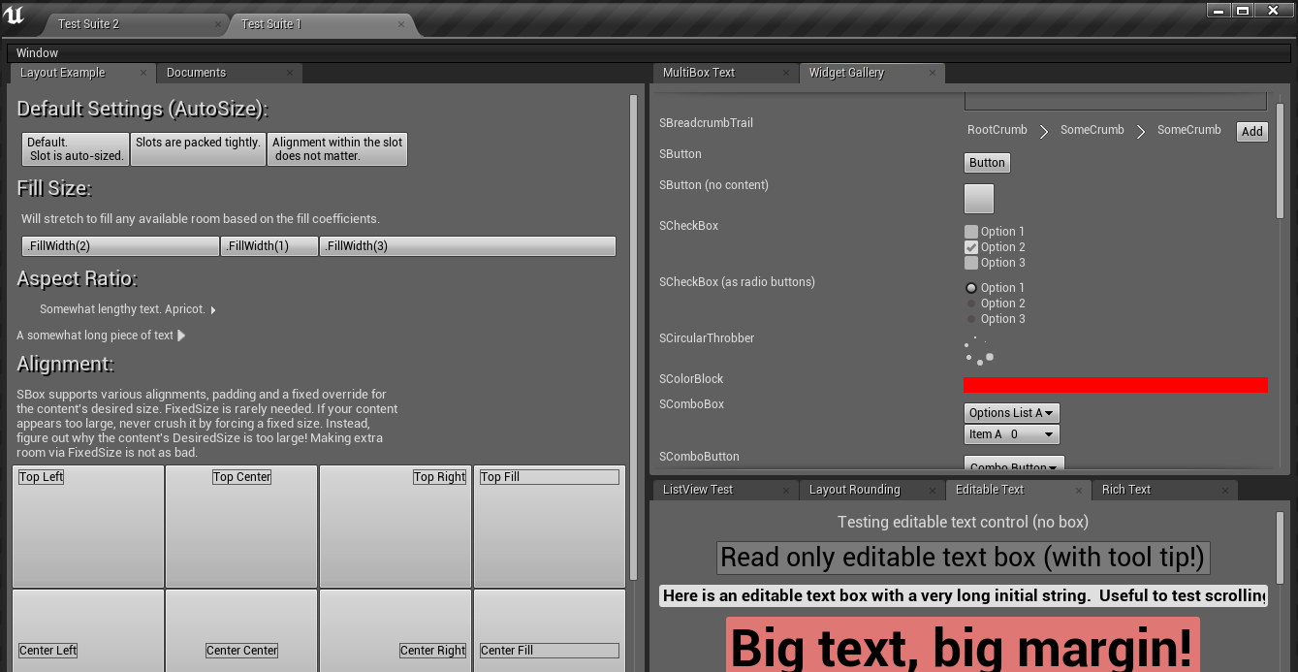
Demo
Notes:
[Widget Reflector Demo]

Slide 10
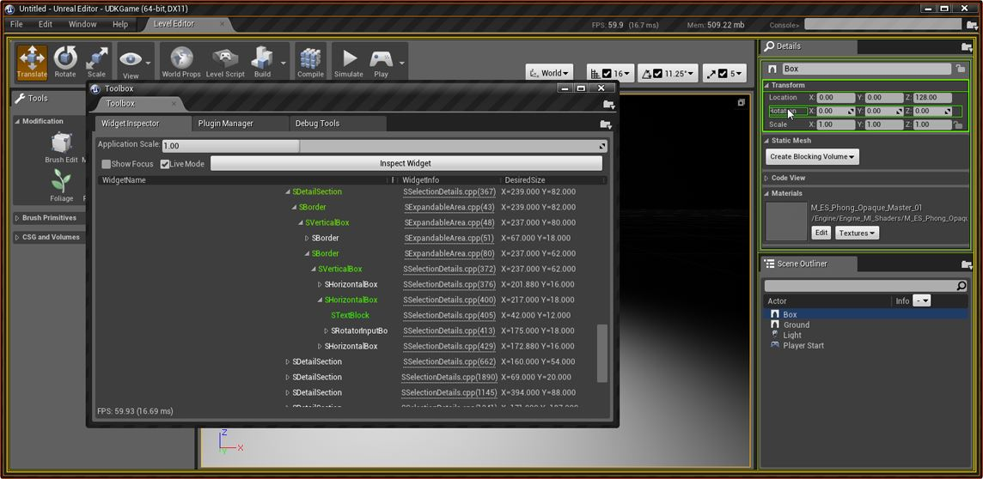
Demo
Notes:
[Widget Reflector Demo]

Slide 11
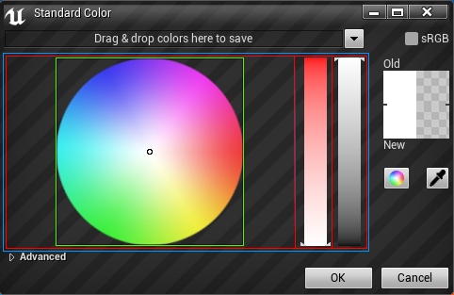
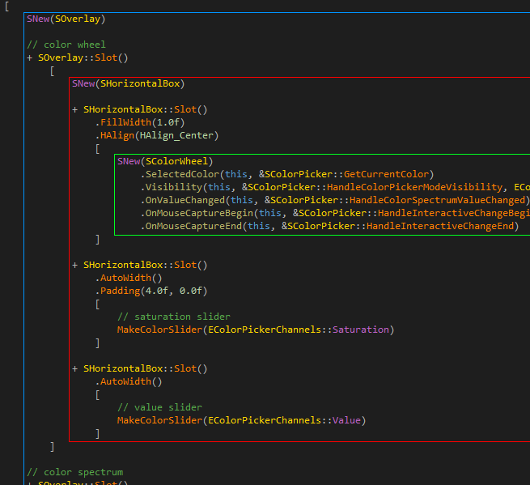
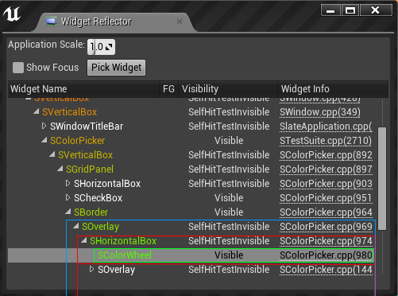
Demo
Notes:
With a little bit of practice you will be able to visualize in your mind what Slate code will look like when rendered.
On the top left we see the Color Picker widget.
Below is the Widget Reflector with focus on the Color Wheel widget inside the color picker.
Notice how all three representations show the same hierarchical relationships (blue, red, green boxes).

Slide 12
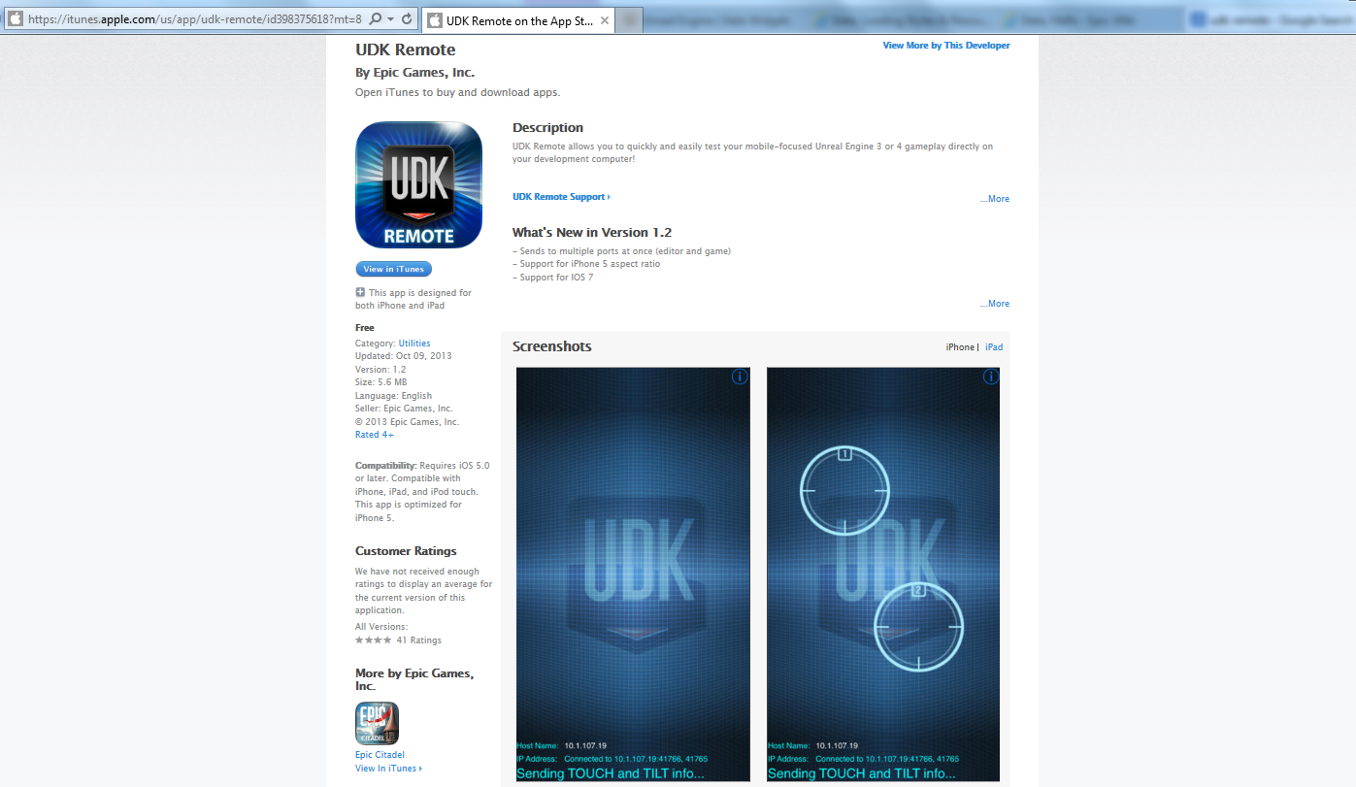
Notes:
You can get the UDK Remote app for iOS on the Apple App Store.
We will soon rewrite this app in Slate, so it also works on Android.

Slide 13
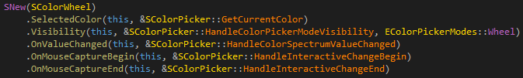
Going A Little Deeper
State Updates
Widget Roles
Anatomy
Attributes
Polling instead of Invalidation
Avoids duplicate state data
Exception: Non-trivial data models (use caches instead)
Performance depends on number of visible widgets
Notes:
For updating its UI, Slate uses Polling instead of Invalidation.
This avoid duplication of UI state data.
It also means you have to be careful about the amount of work you are doing inside callback delegates.
You can see in example for the color wheel that all properties are bound to delegates.
The non-event delegates will be executed every tick.

Slide 14
Going A Little Deeper
State Updates
Widget Roles
Anatomy
Attributes
Fundamental Widget Types
SCompoundWidget – Can have nested child widgets
SLeafWidget – Does not contain child widgets
SPanel – Base class for layout panels
Special Widgets
SWidget – Root base class for all widgets (do not inherit!)
SNullWidget – Empty default widget
User Widgets
More efficient in terms of compile time
Notes:
Although we mostly use composition for creating new widgets, SlateCore defines three truly fundamental widget types that are meant to be inherited.
Most of your custom widgets will inherit from SCompoundWidget, or SLeafWidget if they have no children.
Child slots must always contain a valid widget. SNullWidget is used to fill empty slots.
User widgets were recently added and are still somewhat experimental.

Slide 15
Going A Little Deeper
State Updates
Widget Roles
Anatomy
Attributes
SWidget
SNullWidget
SCompoundWidget
SLeafWidget
SPanel
SBorder
SImage
SBox
SButton
STextBlock
SCanvas
SViewport
SVirtualJoystick
SGridPanel
Notes:
Here you can see how the widget types relate to each other, including some of the widgets I mentioned earlier.
SWidget in red, fundamental widget types in blue, and usable widgets in green.
The vast majority of widgets in the Engine code base are compound widgets.

Slide 16
Going A Little Deeper
State Updates
Widget Roles
Anatomy
Attributes
Common Interfaces
Arguments – Widget parameters that do not change
Attributes – Parameters that are polled
Event handlers – Usually named ‘OnSomeEvent’
Common Internals
ComputeDesiredSize() - Calculates widget’s desired size
ArrangeChildren() - Arranges children within allotted area
OnPaint() – Draws the widget
Notes:
Widgets share a common anatomy.
A widget’s appearance is usually controlled with Arguments and Attributes.
You can also use setter and getter functions if you prefer.
All widgets contain functions to compute their desired size, arrange their child widgets (if any) and paint themselves.

Slide 17

Going A Little Deeper
State Updates
Widget Roles
Anatomy
Attributes
Common Attributes
Enabled state, Visibility, Hit testability
Tooltip Widget, Tooltip Text, Cursor Style
Horizontal & Vertical Alignment , Padding
Attributes Can Be:
Constants, i.e. IsEnabled(false)
Delegate bindings, i.e. IsEnabled(this, &SMyWidget::HandleIsEnabled)
Lambdas are now supported, too!

Slide 18

In-Game UI
HUD Canvas
VP Widgets
Game Menus
FCanvas
Low-level C++ API for drawing directly to the screen
Has been part of Unreal Engine for many years
All functions are in FCanvas class
DrawText(), DrawTexture(), DrawTile(), etc.
Use AHUD.Canvas to access the canvas object
HHitProxy
Provides basic interaction support for FCanvas
Create one hit proxy per interactive object
Hit proxy ID is sent to GPU for per-pixel hit tests
Notes:
While our previous presentation mainly focused on building UI for the Editor and standalone applications, this talk will be about game UI.
The most common type of in-game UI is the Head-Up Display.
The Engine currently provides two mechanisms to generate HUDs: Canvas and HUD Widgets.

Slide 19
In-Game UI
HUD Canvas
VP Widgets
Game Menus
UGameViewportClient
Allows usage of Slate widgets inside game view port
Use all features of Slate (except SWindow)
Add/RemoveViewportWidgetContent()
Things to keep in mind
All added widgets will be layered on top of each other (SOverlay)
Widgets should use TWeakObjPtr for UObject references
Notes:
A better way for creating in-game UI is to use viewport widgets.
The game’s viewport client has an API that allows for adding and removing regular Slate widgets.
Since all UI is usualy displayed inside the game’s window, the use of SWindow is generally discouraged (unless you really want to open external windows from your game).

Slide 20
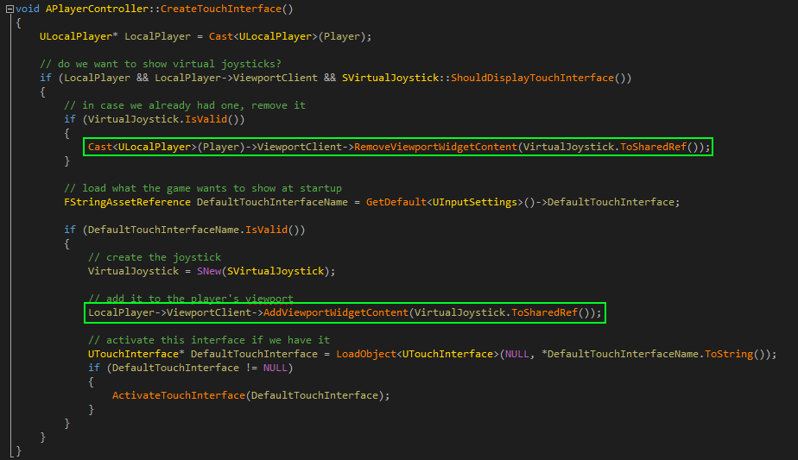
Notes:
Here is some sample code from our PlayerController class that adds and removes a virtual joystick widget to/from the viewport client on demand.

Slide 21
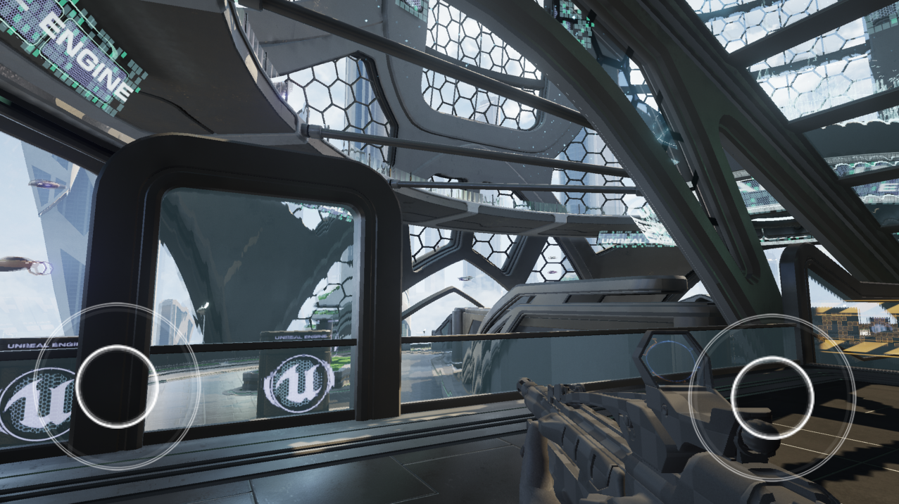
Notes:
And here is what the virtual joystick looks like in game.
Notice the two circles at the bottom left and right, which can be used to control player movement on a mobile device.

Slide 22

In-Game UI
HUD Canvas
VP Widgets
Game Menus
The Hard Way
Use FCanvas to draw your own menus
Not recommended
The Custom Way
Use HUD Widgets to create any menu layout
The Lazy Way
Use GameMenuBuilder for paged menus
FGameMenuPage - Single menu page
FGameMenuItem - An option in a menu page
Can be customized and styled
Mostly used for settings screens
Notes:
Another important type of game UI are in-game menus for settings or game controls.
You can use either of the two techniques just mentioned, or you can leverage the new GameMenuBuilder to get up and running quickly.
Most of our own in-game Uis are currently built with viewport widgets.

Slide 23

What’s New in 4.6?
Slate Improvements
Decreased impact on compilation time
Split built-in widget library into multiple modules
Named slots
Unreal Motion Graphics (UMG)
Artist friendly WYSIWYG editor
2D transformation and animation with Sequencer
Blueprint integration & scripting
Better styling system (work in progress)
Notes:
We continue to make improvements to Slate.
We are currently putting a lot of effort into improving compilation times and breaking out the many available widgets into to separate modules.
Of course, we have also released Unreal Motion Graphics, which is a user interface editor built on top of Slate.
UMG exposes powerful Slate features, such as 2D transformation and Blueprint scripting in designer friendly ways.

Slide 24

Questions?
Documentation, Tutorials and Help at:
AnswerHub:
Engine Documentation:
Official Forums:
Community Wiki:
YouTube Videos:
Community IRC:
Unreal Engine 4 Roadmap
lmgtfy.com/?q=Unreal+engine+Trello+
http://answers.unrealengine.com
http://docs.unrealengine.com
http://forums.unrealengine.com
http://wiki.unrealengine.com
http://www.youtube.com/user/UnrealDevelopmentKit
#unrealengine on FreeNode
Notes:
The easiest way to learn more about Slate is to check out our extensive online documentation, which is available for free to everyone.
Are there any questions right now?

