Slide 1
Programming in UE4
A Quick Orientation for Coders
Gerke Max Preussner
max.preussner@epicgames.com
Notes:
*** Prepared and presented by Gerke Max Preussner for East Coast MiniDevCon 2014, November 12-13th
Hi, my name is Max. I work as a Sr. Engine Programmer at Epic Games and would like to give you a quick introduction to programming in Unreal Engine 4.
Who in the audience is a programmer?
Who thinks that programming is awesome?
Yes, programming is awesome…

Slide 2

Programming
Is Awesome
Sucks
But…
Because you can:
Create something from nothing
Bring dead matter to life
Improve the human condition
Impress your girl/boyfriend/cat
Make a good living in the process
Notes:
… because it empowers you to create really cool things from the comfort of your armchair, and to make other people’s life better, or at least more entertaining.

Slide 3
Programming
Is Awesome
Sucks
But…
Because:
Programmers are crazy
Programming languages & tools suck
All code is bad and buggy
There is never enough time to do it right
You are always behind the curve
Peter Welch: http://stilldrinking.org/programming-sucks
Notes:
Programming also really sucks… because all programmers are crazy!
Who read Peter Welch’s blog post “Programming Sucks”?
It is the most accurate description of what it is like to be a programmer and work in a programming team.
Welch argues that all programming teams are composed by and of crazy people. He also describes how most programmers start writing perfect little snowflakes, and on Friday they are told that six hundred more snowflakes are needed by next Tuesday. And then a lot of sketchy code gets dumped into a pile of snow that quickly melts together, and some of it turns yellow because a cat peed on it.
All large teams end up working this way, and Epic is no exception. We, too, are crazy – perhaps in a good way, or at least with good intentions. We are successful, because we have more snowflakes than others, and the remaining pile is split into manageable parts, and the yellow snow is hidden, because someone leaned a Picasso against it.
Who thinks that C++ is awesome?
C++ also sucks… but so does every other programming language! They all suck, just in different ways. Most of the time it is because we are trying to use them in ways they were not designed for, and there is no language that solves all software engineering problems well.

Slide 4
Programming
Is Awesome
Sucks
But…
Don’t get discouraged!
If it was easy, a monkey could do it!
Don’t be afraid of programming languages
Don’t get discouraged by complex code bases
There are ways to make your life easier
Know your tools and keep learning
Software Design and Architectural Patterns
Coding Guidelines & Best Practices
Transfer knowledge with your peers
Notes:
But do not despair!
I will quickly show you a few things to get up and running with Unreal and make your life easier.

Slide 5
Getting Started
Get All The Things!
Download and install Unreal Engine 4
Sync the latest code from GitHub (either Release or Master branch)
Don’t forget to download & install the required dependencies!
Tools:
Windows: Visual Studio, UnrealVS, Visual Assist X (recommended)
MacOS: Xcode
Linux: Check the Wiki for latest instructions!
For everything else see:
https://docs.unrealengine.com/latest/INT/Programming/QuickStart/
Notes:
By the way, we have really great documentation on our website for getting you started, so I won’t go into too much detail.
After installing UE4 you can go to GitHub and download the latest source code.
Don’t forget to download and install the required dependencies (ZIP files) as well (instructions are on the GitHub page).
We currently support development on Windows and MacOS, and there is also preliminary support for Linux.
If you work in Visual Studio we highly recommend installing our UnrealVS plug-in.

Slide 6

Common Blockers
Compiling
Acronyms
Entry Point
Compiling is handled through Unreal Build Tool (UBT)
Solution/Projects in Visual Studio & Xcode are a lie!
Pre-processes header files (UHT)
Generates magic glue code
Invokes platform specific compilers
Supports remote compiling, too
Also generates IDE project files
Notes:
Now, let’s start with some of the most common blockers for programmers just starting with Unreal Engine.
The first thing that throws off a lot of people is that compilation is not actually performed by Visual Studio or Xcode, but by our Unreal Build Tool.
Visual Studio and XCode solutions are only generated for your convenience. We do this so that we can support different IDEs.
In combination with Unreal Header Tool, it also performs a lot of code pre-processing.
I will talk about this in more detail in another presentation later today.

Slide 7
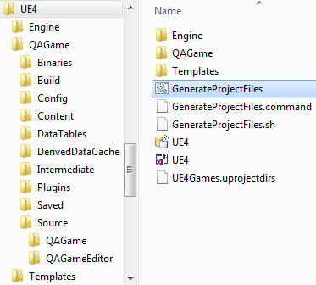
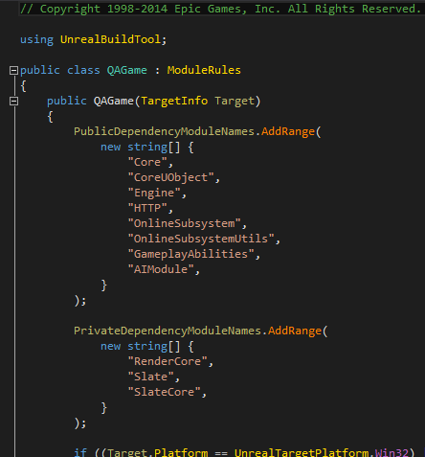
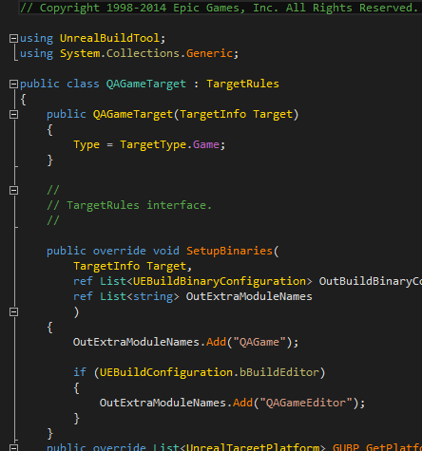
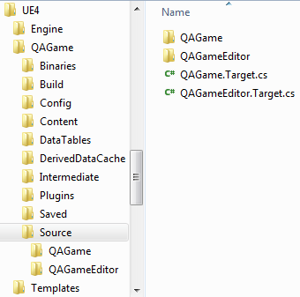
Build Rules
Notes:
UBT uses special C# files (*.Build.cs and *.Target.cs) that you create inside your module directories to figure out what it needs to do.
Here you can see the build and target rules files for QAGame, a special game that our QA team uses for internal testing.

Slide 8

Dependency Graph
Notes:
Another little known feature of UBT is the ability to generate dependency graph data that can be visualized.
Here is a screenshot of a JavaScript based visualizer that shows a section of our code base.

Slide 9
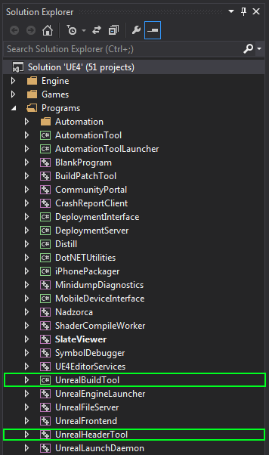
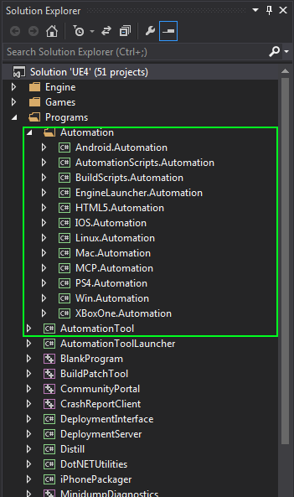
UBT, UHT, UAT Projects
Notes:
The full source code for all three tools is included with the Engine.
You can find it in the Engine’s “Programs” directory on GitHub.
Besides UBT and UHT there is also UAT (Unreal Automation Tool), which is used for packaging, launching and deploying your projects.

Slide 10
Common Blockers
Compiling
Acronyms
Entry Point
Acronym Soup…
UBT – Unreal Build Tool
UHT – Unreal Header Tool
UAT – Unreal Automation Tool
UFE – Unreal Frontend
BP – Blueprint
CDO – Class Default Object
INI – Text Based Configuration File
etc.
Notes:
By now you are probably aware of our generous use of acronyms.
I already mentioned UBT, UHT and UAT, and there are many others.
Don’t worry, you will quickly learn and get used to all of them.

Slide 11
Common Blockers
Compiling
Acronyms
Entry Point
… and Code Names, too!
Cascade – Particle System Editing Tool
Cooking – Process of optimizing game content
Lightmass – Pre-computed Global Illuminaton
Matinee – In-game Cinematics Tool
Persona – Animation Editing Tool
PhAT – Physics Asset Tool
Swarm – Distributed Computing Client
etc.
Notes:
We also use code names for some of our tools, and you may stumble upon them in our documentation.
The names are often chosen by the developers themselves.
For example, Cascade is our particle system editor.
It will soon be replaced with a completely rewritten version that is code named Niagara.
Swarm is a C# program that allows for distributing expensive work to other computers on your network.
It is currently only used by Lightmass and will soon be rewritten C++.

Slide 12

Common Blockers
Compiling
Acronyms
Entry Point
Where Is the Main Loop?
LaunchEngineLoop.cpp
It’s really complicated (and everybody hates it)
Please don’t bother with this – start with our tutorials!
Notes:
If you have experience writing your own little game from scratch, you may be tempted to locate our Engine’s main entry point in an attempt to learn something about how it all works.
This is the wrong way to get started. You cannot possibly learn anything useful from this, because most of the code you will use on a daily basis is on a much higher conceptual layer… with about two million lines of other stuff in between.
Read and watch our programming tutorials instead!

Slide 13
Unrealisms
Type Names
UObjects
Basic Types
Strings
Macros
We Use Prefixes for All Types
U – UObject derrived class, i.e. UTexture
A – AActor derrived class, i.e. AGameMode
F – All other classes and structs, i.e. FName, FVector
T – Template, i.e. TArray, TMap, TQueue
I – Interface class, i.e. ITransaction
E – Enumeration type, i.e. ESelectionMode
b – Boolean value, i.e. bEnabled
Everything in Unreal is Pascal Case (Upper Camel Case)
Function names and function parameters, too
Even local and loop variables!
Notes:
You will notice that we use prefixes for all our types, and there is no logical explanation for it.
The story goes that Tim Sweeney, when he started working on Unreal Engine in his Garage, added FVector for 3D vectors with floating point components and a U-prefix for Unreal game classes.
When other programmers joined they assumed that these were naming conventions… and that’s how snowflakes turn into yellow snow.
We also use upper-case for all names in C++. It may really upset your OCD, but please don’t try to fight this convention as it will help keeping everything consistent.
It may take a while, but you will get used to it.

Slide 14
Unrealisms
Type Names
UObjects
Basic Types
Strings
Macros
UObjects Work Around Limitations in C++
Run-time reflection of class properties and functions
Serialization from/to disk and over the network
Garbage collection
Meta data
Also: Blueprint integration
Decorate regular C++ Classes with Magic Macros
UCLASS – for class types
USTRUCT – for struct types
UFUNCTION – for class and struct member functions
UPROPERTY – for class and struct variables
Notes:
C++ is great for a lot of things, but it is also lacking useful features that are present in more modern programming languages, such as Java or C#.
Runtime reflection, garbage collection and automatic serialization are the most important ones.
We would still like to use those features, so we implemented them on top of C++ with the help of macros that will be parsed by Unreal Header Tool.
These special decorators will cause UHT to automatically generate all the glue code that is required to make this work.

Slide 15

Unrealisms
Type Names
UObjects
Basic Types
Strings
Macros
// Example (omitting some more advanced details)
USTRUCT() // magic!
struct FVector2D
{
UPROPERTY() // magic!
float X;
UPROPERTY() // magic!
float Y;
UFUNCTION () // magic!
float GetLength() const;
};
Notes:
Here is an example for how a C++ structure for 3D vectors may be marked up in this way.
From this, Unreal Header Tool will generate all the glue code, and you will most likely never have to see it.

Slide 16
Unrealisms
Type Names
UObjects
Basic Types
Strings
Macros
Fundamental Types
We don’t use C++ integer types (char, short, int, long, etc.)
Custom typedef’s for ints & strings in GenericPlatform.h (int32, uint32, uint64, TCHAR, ANSICHAR etc.)
Numeric type traits in NumericLimits.h
Common Structures
FBox, FColor, FGuid, FVariant, FVector, TBigInt, TRange
And many more in Core module
Notes:
All our fundamental types are declared in the Core module.
We have platform specific type definitions for numeric types and strings.
We don’t actually use the standard numeric types that are part of the C++ standard.
This allows us to hide platform specific behavior of fundamental types.

Slide 17
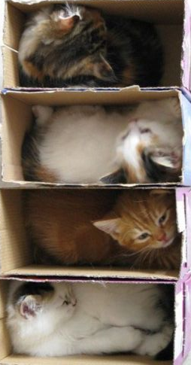
Unrealisms
Type Names
UObjects
Basic Types
Strings
Macros
Containers
TArray, TSparseArray – Dynamic arrays
TLinkedList, TDoubleLinkedList
TMap – Key-value hash table
TQueue – Lock free FIFO
TSet – Unordered set (without duplicates)
And many more in Core module
Delegates
Unicast and multicast delegates
Also thread-safe variants…
Notes:
The Core module also contains many generic container types.
We also have an implementation for various kinds of event delegates…

Slide 18
Unrealisms
Type Names
UObjects
Basic Types
Strings
Macros
Smart Pointers
TSharedPtr, TSharedRef – for regular C++ objects
TWeakPtr – for regular C++ objects
TWeakObjPtr – for UObjects
TAutoPtr, TScopedPtr
TUniquePtr
Similar to boost:: & std:: implementations
Also thread-safe variants
Notes:
There is also a library of smart pointer implementations.
The most common ones are shared pointers, which also come with thread-safe variants.
Shared pointers simplify the lifetime management of objects, and we use them often.

Slide 19

Unrealisms
Type Names
UObjects
Basic Types
Strings
Macros
String Types
FString – Regular string
FText – Localized string, used heavily in Slate UI
FName – String hash, used heavily in UObjects
String Literals
TEXT() – Creates a regular string TEXT(“Hello”);
LOCTEXT() – Creates a localized string LOCTEXT(“Namespace”, “Name”, “Hello”);
NSLOCTEXT() – LOCTEXT with scoped namespace NSLOCTEXT(“Name”, “Hello”);
Notes:
String types can be a bit confusing at first, because we distinguish between regular and localized string objects.
They each come with special macros for string literals.
We also have so called FNames, which store string values in a global hash table.
These are very heavily used in the UObject sub-system to identify classes, functions and properties.

Slide 20

Unrealisms
Type Names
UObjects
Basic Types
Strings
Macros
FNames are case-insensitive!
Can’t rename misspelled names in the Editor (FIXED!)
Can’t name a C++ property ‘Blast’ if one ‘bLast’ exists
Notes:
Oh, and FNames are case-insensitive.
If you ever wondered why you can’t correct spelling errors in the Editor right now, that is the reason why.
And if you think that’s crazy… well… that’s because it is!

Slide 21
Unrealisms
Type Names
UObjects
Basic Types
Strings
Macros
Logging
UE_LOG, also GLog->Logf()
Assertions
check(), checkSlow(), ensure()
Localization
LOCTEXT_NAMESPACE, LOCTEXT, etc.
Slate (UI Framework)
SLATE_BEGIN_ARGS, SLATE_ATTRIBUTE, etc.
Notes:
We also use macros for less complicated things, such as logging and assertions.
These are some macros you will likely encounter when working on your project.

Slide 22
Best Practices
Guidelines
Principles
Coding Guidelines
Posted on http://docs.unrealengine.com
There are some inconsistencies in the code base
If in doubt, follow existing style in current code file
Naming Conventions
Choose descriptive names that are as short as possible
Also for local and loop variables!
Avoid your own acronyms
Notes:
We have an internal coding guidelines document that is not yet posted on the Wiki.
Since so many programmers from inside and outside Epic are involved, you will find some inconsistencies in style.
And, of course, choosing good names for modules, classes, functions and variables is by far the most difficult task for programmers, but also one of the most important ones.

Slide 23
Best Practices
Guidelines
Principles
General Principles
KISS, YAGNI
Composition vs. inheritance
Avoid tight coupling of code and modules
Many trivial instead of few complicated components
Design Patterns
SOLID (especially S, O, L and I; DI is not elegant in C++)
Hollywood Principle (especially for Slate & game code)
GOF, EIP
Methodologies
DDD, TDD (we support unit tests), AOP
Notes:
We also try follow proper software design principles more often now.
You may already be familiar with some of them, such as KISS and YAGNI.
One of the most important, but less known object-oriented principle is SOLID.
[more details here, if time available]
We also use common patterns from Gang-Of-Four and Enterprise Integration Patterns.
Other methodologies we’re experimenting with are Domain-Driven Design, Test-Driven Development and Aspect Oriented Programming for cross-cutting concerns.
Those are all huge topics in themselves. I will have to talk about them another time.

Slide 24

Questions?
Documentation, Tutorials and Help at:
AnswerHub:
Engine Documentation:
Official Forums:
Community Wiki:
YouTube Videos:
Community IRC:
Unreal Engine 4 Roadmap
lmgtfy.com/?q=Unreal+engine+Trello+
http://answers.unrealengine.com
http://docs.unrealengine.com
http://forums.unrealengine.com
http://wiki.unrealengine.com
http://www.youtube.com/user/UnrealDevelopmentKit
#unrealengine on FreeNode
Notes:
Make sure to check out our extensive materials on the internet, all of which are available for free – even if you don’t have a subscription yet.
Any questions?

