Slide 1
Concurrency & Parallelism in UE4
Tips for programming with many CPU cores
Gerke Max Preussner
max.preussner@epicgames.com
Notes:
*** Prepared and presented by Gerke Max Preussner for East Coast MiniDevCon 2014, November 12-13th
Hi, my name is Max. I work as a Sr. Engine Programmer at Epic Games and would like to give you a quick overview of multi-threading capabilities in Unreal Engine 4.
Games and applications that perform concurrent tasks on one or multiple CPUs or CPU cores are generally hard to write, proof correct, debug and maintain.
Not only are there many concepts and mechanisms you have to learn, but also a wide range of very subtle issues that are often dependent on the operating system and the processor it is running on.
Unreal Engine provides a range of features, helpers and tools to develop for multi-core computers and mobile devices more easily.

Slide 2
Synchronization Primitives
Atomics
Locking
Signaling
Waiting
FPlatformAtomics
InterlockedAdd
InterlockedCompareExchange (-Pointer)
InterlockedDecrement (-Increment)
InterlockedExchange (-Pointer)
64- and 128-bit overloads on supported platforms
Notes:
At the lowest level, the Engine provides a number of synchronization primitives used to synchronize memory access across different threads.
Commonly used primitives are atomic operations, mechanisms for locking and signaling threads, as well as for waiting on events from other threads.
Atomic operations allow the CPU to read and write a memory location in the same indivisible bus operation.
Although this seems to be a rather trivial feature, it is the foundation of many higher level multi-threading mechanisms.
The main advantage of atomics is that they are very quick compared to locks, and they avoid the common problems of mutual exclusion and deadlocks.
Unreal Engine exposes various atomic operations, such as incrementing and compare-and-exchange in a platform agnostic API.
Most atomic operations operate on 32-bit values, but we also provide APIs for 64- and 128-bit values, if the particular platform supports them.

Slide 3
Synchronization Primitives
Atomics
Locking
Signaling
Waiting
// Example
class FThreadSafeCounter {
public: int32 Add( int32 Amount ) {
return FPlatformAtomics::InterlockedAdd(&Counter, Amount);
} private:
volatile int32 Counter; };
Notes:
Here is an example from our code base that uses atomics to implement a thread-safe counter.
A normal increment instruction for integers may involve multiple bus operations that read the current value, increment it and write it back to memory.
During these multiple steps it is possible – in principle and in practice – that the operating system suspends our thread, and another thread that also wishes to increment the counter modifies our value, causing that increment to be lost when our thread resumes.
The use of ‘interlocked add’ in this example ensures that the increment operation cannot be interrupted.
Because the counter value can change in asynchronous ways that the compiler cannot foresee, we use the volatile keyword to prevent optimizations of code that accesses the value.

Slide 4
Synchronization Primitives
Atomics
Locking
Signaling
Waiting
Critical Sections
FCriticalSection implements synchronization object
FScopeLock for scope level locking using a critical section
Fast if the lock is not activated
Spin Locks
FSpinLock can be locked and unlocked
Sleeps or spins in a loop until unlocked
Default sleep time is 0.1 seconds
Notes:
The main locking mechanisms used in Unreal Engine are Critical Sections and Spin Locks.
Critical Sections provide mutually exclusive access to a single resource, usually the internals of a thread-safe class.
In combination with Scope Locks they ensure that a given block of code can be executed by only one thread at a time.
Compared to atomic operations, they can be a lot slower when the lock is accessed by more than one thread.
Spin Locks also provide exclusive access, but instead of using the mutex facilities provided by the OS they sleep in a loop until the lock is removed.
The sleep time is configurable (0.1 seconds by default), and for very small durations they may actually just do a no-op spin loop under the hood.

Slide 5
Synchronization Primitives
Atomics
Locking
Signaling
Waiting
Semaphores
Like mutex with signaling mechanism
Only implemented for Windows and hardly used
API will probably change
Use FEvent instead
Notes:
Semaphores are similar to mutual exclusion locks, but they also contain a signaling mechanism.
There is currently an implementation in FPlatformProcess, but it is not quite what one would expect, only implemented for Windows and only used in Lightmass right now.
A better choice for signaling between threads would be the FEvent class…

Slide 6
Synchronization Primitives
Atomics
Locking
Signaling
Waiting
FEvent
Blocks a thread until triggered or timed out
Frequently used to wake up worker threads
FScopedEvent
Wraps an FEvent that blocks on scope exit
// Example for scoped events
{
FScopedEvent Event;
DoWorkOnAnotherThread(Event.Get());
// stalls here until other thread triggers Event
}
Notes:
… which also uses a mutex under the hood.
We frequently use events in worker threads to notify them about newly added work items or that we wish to shut them down.
If you just want to send a one-shot signal from another thread, you can pass an FScopedEvent into it, and your current thread will stall when the event exits its scope until it is triggered.

Slide 7
High Level Constructs
Containers
Helpers
General Thread-safety
Most containers (TArray, TMap, etc.) are not thread-safe
Use synchronization primitives in your own code where needed
TLockFreePointerList
Lock free, stack based and ABA resistant
Used by Task Graph system
TQueue
Uses a linked list under the hood
Lock and contention free for SPSC
Lock free for MPSC
TDisruptor (currently not part of UE4)
Lock free MPMC queue using a ring buffer
Notes:
Most container types and classes in the Engine, including TArray and TMap are not thread-safe.
We usually just manually add atomics and mutual exclusion locks in our code on an as-needed basis.
Of course, locks are not always desirable, so we are also starting to implement basic lock-free containers that are thread-safe.
A very useful lock-free container is TQueue, which is lock- and contention-free for SPSC and lock-free for MPSC.
It is used in many places that transfer data from one thread to another.
(We also implemented a lock-free MPMC queue using the Disruptor pattern at some point – it is not part of UE4 right now, but if you need it, send me an email!)

Slide 8
High Level Constructs
Containers
Helpers
FThreadSafeCounter
FThreadSingleton
Singleton that creates an instance per thread
FMemStack
Fast, temporary per-thread memory allocation
TLockFreeClassAllocator, TLockFreeFixedSizeAllocator
Another fast allocator for instances of T
FThreadIdleStats
Measures how often a thread is idle
Notes:
We also provide some high level helper objects that are built on top of the synchronization primitives, some of which are shown here.
The thread-safe counter we have already seen in the code example earlier.
Thread-safe singletons are special singletons that create one instance of a class per thread instead of per process.
Memory stacks allow for ultra-fast per-thread memory allocations.
We also have a way to measure thread idle times that is always enabled, even in Shipping builds.

Slide 9
Parallelization
Threads
Task Graph
Processes
Messaging
FRunnable
Platform agnostic interface
Implement Init(), Run(), Stop() and Exit() in your sub-class
Launch with FRunnableThread::Create()
FSingleThreadRunnable when multi-threading is disabled
FQueuedThreadPool
Carried over from UE3 and still works the same way
Global general purpose thread pool in GThreadPool
Not lock free
Notes:
Traditionally, the main work horse of multi-threaded programming are operating system threads.
We expose those in the form of the FRunnable base class that you can inherit from.
If your thread object inherits from FSingleThreadRunnable, it can also be used when multi-threading is disabled or unavailable.
The thread pool from Unreal Engine 3 is still available as well.
You can create your own thread pools or just use the global one in GThreadPool.

Slide 10
Parallelization
Threads
Task Graph
Processes
Messaging
Game Thread
All game code, Blueprints and UI
UObjects are not thread-safe!
Render Thread
Proxy objects for Materials, Primitives, etc.
Stats Thread
Engine performance counters
Notes:
Unreal Engine 4 uses threads for a number of things, but the most important ones are GameThread, RenderThread and StatsThread.
All code that interfaces with UObjects must run on the GameThread, because UObjects are not thread-safe.
The RenderThread allows us to perform rendering related tasks in parallel with the game logic.
We recently also added the StatsThread that collects and processes a number of perforce counters for profiling.

Slide 11
Parallelization
Threads
Task Graph
Processes
Messaging
Task Based Multi-Threading
Small units of work are pushed to available worker threads
Tasks can have dependencies to each other
Task Graph will figure out order of execution
Used by an increasing number of systems
Animation evaluation
Message dispatch and serialization in Messaging system
Object reachability analysis in garbage collector
Render commands in Rendering sub-system
Various tasks in Physics sub-system
Defer execution to a particular thread
Notes:
Threads are very heavyweight.
Task Based Multi-Threading allows for more fine grained, lightweight use of multiple cores.
A task is a small, parallelizable unit of work that can be scheduled to available worker threads that are managed by our Task Graph system.
As the name suggests, tasks can also have dependencies on each other, so that certain tasks are not executed until other tasks completed successfully.
The Task Graph is used by an increasing number of systems in the Engine, and we encourage you to use it, too.

Slide 12
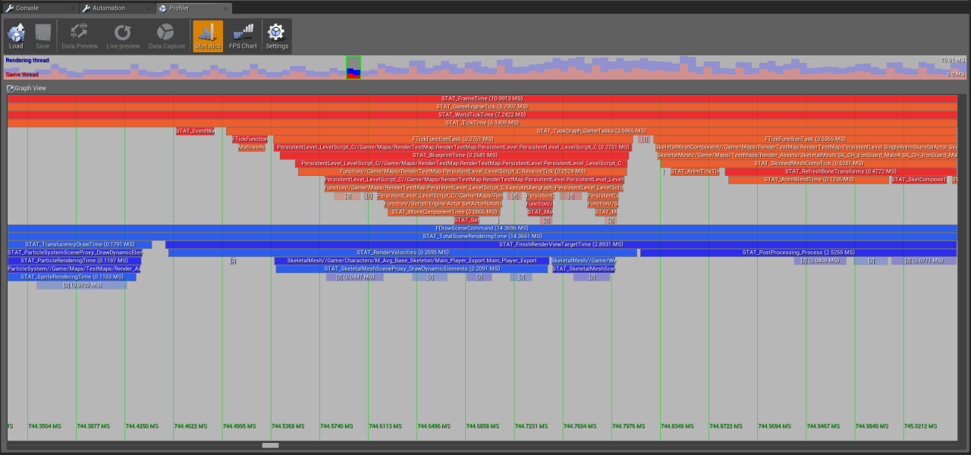
Notes:
The Profiling Tools in the Editor come with a handy feature for visually debugging threads.
It shows the cycle counter based statistics, as well as Task Graph usage.

Slide 13
Parallelization
Threads
Task Graph
Processes
Messaging
FPlatformProcess
CreateProc() executes an external program
LaunchURL() launches the default program for a URL
IsProcRunning() checks whether a process is still running
Plus many other utilities for process management
FMonitoredProcess
Convenience class for launching and monitoring processes
Event delegates for cancellation, completion and output
Notes:
Unreal Engine 4 also has platform agnostic APIs for creating and monitoring external processes.
You can start programs, launch web URLs or open files in other applications.
If you need fine control over creating and monitoring external processes, you can use the FMonitoredProcess class.

Slide 14
Parallelization
Threads
Task Graph
Processes
Messaging
Unreal Message Bus (UMB)
Zero configuration intra- and inter-process communication
Request-Reply and Publish-Subscribe patterns supported
Messages are simple UStructs
Transport Plug-ins
Seamlessly connect processes across machines
Only implemented for UDP right now (prototype)
Notes:
Messaging is another important architectural pattern for multi-threaded and distributed applications.
Unreal Message Bus implements a message passing infrastructure that can be used to send commands, events or data to other threads, processes and even computers.
Our main goal was to unify all the different network communication technologies we used for our tools in UE3, and to allow users to create their own distributed applications and tools without having to deal with low level technicalities, such as network protocols and how exactly messages get from A to B.
Messages are simple Unreal structures (that currently require a tiny bit of boilerplate, but we will fix that soon).
They can be sent between devices, even across the internet - if desired – and all our Unreal Frontend tools heavily rely on it.
Messaging is a great way to get information out of your code classes in a loosely coupled way, and future use cases may include achievement systems, event processing for AI and real-time remote editing on game consoles and mobile phones.

Slide 15
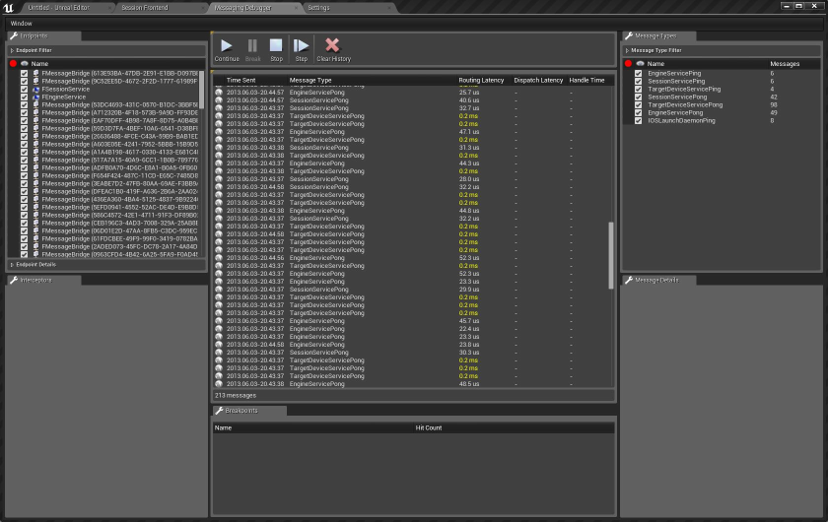
Notes:
Debugging the flow of messages tends to be quite cumbersome in code, so the Messaging system comes with a visual debugging tool as well.
It is not quite finished yet, but already functional.

Slide 16
Upcoming Features
Critical sections & events
Better debugging and profiling support
Task Graph
Improvements and optimizations
UObjects
Thread-safe construction and destruction
Parallel Rendering
Implemented inside renderers, not on RHI API level
Messaging
UDP v2 (“Hammer”), BLOB attachments, more robust, breakpoints
Named Pipes and other transport plug-ins
More lock-free containers
Notes:
We are continuously working on improving and extending Unreal Engine 4.
That UObjects are not thread-safe is sometimes a limitation, and we are currently working on allowing their construction and destruction on non-Game threads.
We are also working on parallelizing the Renderer. This will be implemented not in the RHI API, but in the renderers themselves and utilize the Task Graph.
The Messaging System will become very important for the new Editor tools we have scheduled for next year, so we will make it more powerful and easier to use as well.
Much of our thread-safe code is currently lock based, and we have gotten good results with it, but we are also planning to add more generic lock-free containers.

Slide 17

Questions?
Documentation, Tutorials and Help at:
AnswerHub:
Engine Documentation:
Official Forums:
Community Wiki:
YouTube Videos:
Community IRC:
Unreal Engine 4 Roadmap
lmgtfy.com/?q=Unreal+engine+Trello+
http://answers.unrealengine.com
http://docs.unrealengine.com
http://forums.unrealengine.com
http://wiki.unrealengine.com
http://www.youtube.com/user/UnrealDevelopmentKit
#unrealengine on FreeNode
Notes:
With that I would like to conclude this talk.
Make sure to check out our extensive materials on the internet, all of which are available for free – even if you don’t have a subscription yet.
Are there any questions I can answer right now?

