Slide 1
Game Programming in UE4
Game Framework & Sample Projects
Gerke Max Preussner
max.preussner@epicgames.com
Notes:
Prepared and presented by Gerke Max Preussner for East Coast MiniDevCon 2014, Novemver 12-13th
Email max.preussner@epicgames.com in case of comments, questions or suggestions or visit our AnswerHub at http://answers.unrealengine.com

Slide 2
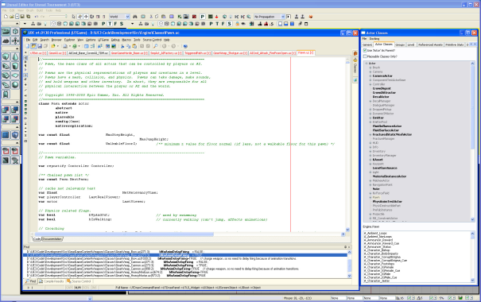
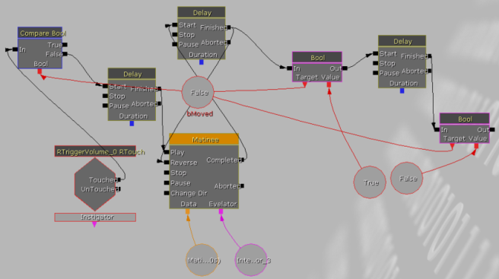
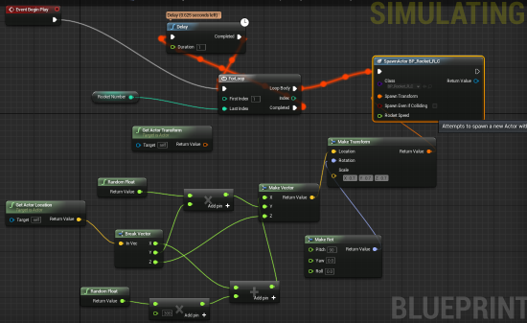
Game Framework History
UE1 and UE2
Designed for First Person Shooters (FPS)
UnrealScript game scripting language
UE3
Kismet Visual Scripting added
More modular game classes
But still very FPS centric
UE4
UnrealScript replaced with Blueprints
Game genre agnostic
Lots of sample projects!
Notes:
Previous versions of Unreal Engine were primarily designed for first person shooter games, because that’s the kind of games Epic used to make.
Unreal Engine 4 is much more game agnostic, and it ships with a ton of sample games for different genres.
Game scripting was part of the engine from the very beginning.
After spending several years of learning Unreal Script, you may be excited to hear that we got rid of it.
Unreal Script has been replaced with Blueprints.

Slide 3
UnrealScript vs. C++ vs. Blueprints
UnrealScript was:
An object-oriented scripting language
Similar in syntax to C, C++, Java, but also somewhat different
Compiled to virtual machine byte code
Adding interesting features, such as States, Timers, Delegates
Blueprints are:
A visual scripting system that is artist and designer friendly
Using the same virtual machine as UnrealScript
Almost as powerful as UnrealScript, and in some ways even better
C++ has:
Always been part of UE game programming
Tight bi-directional integrations with the virtual machine
Been greatly improved in UE4 to replace UnrealScript for coders
Blueprints
VM
C++
Notes:
Unreal Script was a completely separate programming language, although it was similar to C++ and Java.
Blueprints are now at least as powerful as UnrealScript and offer some interesting new possibilities.
C++ has been augmented with more macros to give it more of the abilities that Unreal Script used to have.

Slide 4
So What Is The Game Framework?
Overview
Why Use It?
Set Of Foundation Classes
Provide basic structure and functions of your game
You derive from the classes that you need
Fill in the details for your particular game
What’s Missing?
Game genre specific implementations
No concept of health and death
No built-in classes for weapons, inventory, etc.
Notes:
Unreal Engine comes with the so called Game Framework that makes it easier to create new games from scratch.
It is a set of classes that provide all the basic functionality needed for most games.
Since the Engine is now more game agnostic, it no longer contains concepts for health and weapons.
You have to create those yourself for your particular game, or use one of the project templates as a starting point.

Slide 5
So What Is The Game Framework?
Overview
Why Use It?
Reduced Learning Curve
Hides the low-level details of game engines
Benefit from 20+ years of game developing experience
Many samples and tutorials for solving common tasks
High Productivity
Focus on what really matters to you: making your game
Solves many tricky problems in games (movement, input, etc.)
Greatly reduces boilerplate code needed for all games
Scalability
Smoothly grow your game & team from prototype to AAA
Notes:
Why should you use the Game Framework?
Because it takes care of many of the low-level things that every game needs.
Epic Games has been making games for over 20 years, and all that experience flows back into the framework.
Let us worry about the technicalities – you focus on making cool games.

Slide 6

Fundamental Concepts
Actors
Components
Pawn
Controller
Character
HUD
GameMode
What is an Actor?
Entity in a game level
Usually contains one or more Actor Components
Supports network replication for multiplayer games
Things to know about Actors
Don’t have Location, Rotation (stored in root component)
Created with SpawnActor() method
Must be destroyed explicitly with Destroy() method
Will not be garbage collected during the game
Notes:
There are a number of concepts in the Game Framework, but some are particularly important.
The most important one is Actor, because every interactive entity in your game will be an Actor.
Actors have built-in support for network replication, and they can be heavily customized with Actor Components.

Slide 7
Fundamental Concepts
Actors
Components
Pawn
Controller
Character
HUD
GameMode
What is an ActorComponent?
Reusable functionality that can be added to an Actor
Contain the most interesting functionality & events
Also accessible in Blueprints!
Example Components:
Scene Component – Adds transforms and attachments
Primitive Component – Adds collision and rendering
UAudioComponent, UArrowComponent, UInputComponent, ULightComponent, UMeshComponent, UParticleSystemComponent and many more!
Notes:
Actor Components are little reusable pieces of functionality that you can attach to Actors.
They really implement the most interesting parts of what an Actor actually does and what it looks like in your game.
Scene and Primitive Components are the most frequently used Actor Components.
They provide things like appearance, collision and 3D transformations.

Slide 8
Fundamental Concepts
Actors
Components
Pawn
Controller
Character
HUD
GameMode
PrimiviteComponent Event Examples
Hit – Called when bumping into a wall
Begin/EndOverlap – Walk into or out of a trigger
Begin/EndCursorOver
Clicked/Released
InputTouchBegin/End
Begin/EndTouchOver
Notes:
Actor Components can generate events that are accessible in both Blueprints and C++.
For example, when an Actor touches a wall or some other actor, you can react to it by monitoring the Hit event.
Many Actor Components define their own events.

Slide 9

Fundamental Concepts
Actors
Components
Pawn
Controller
Character
HUD
GameMode
What is a Pawn?
An agent in the world
Optionally possessed by a Controller
Usually handles movement and input
Things to know about Pawns
Good place to implement health
No movement or input code by default
Notes:
The second most important concept is the Pawn.
A Pawn is an entity in your game that can be controlled by a Player or some artificial intelligence.
In earlier versions of Unreal Engine, Pawns were mostly used for humanoid creatures.
In UE4 they can be anything, including space ships, submarines or eight legged robots.

Slide 10
Fundamental Concepts
Actors
Components
Pawn
Controller
Character
HUD
GameMode
What is a Controller?
A brain that can possess a Pawn
PlayerController: Represents a human player
AIController: Computes AI behavior for Pawns
Things to know about Controllers
Possess one Pawn at a time
Can persist after possessed Pawn dies
Notes:
Pawns do not control themselves.
They are controlled by so called Controllers, which you can think of as the brain of a Pawn.
Human players use a special controller, called the Player Controller.
AI pawns can be controlled with AI Controllers.
A Pawn may die in your game and disappear, but the Controller can stick around.
For example, when a player respawns, we usually attach the same PlayerController to a new Pawn.

Slide 11
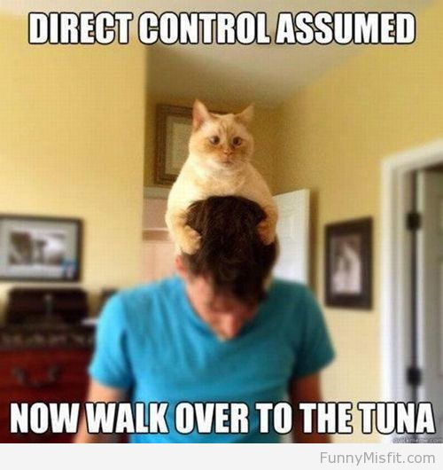
Fundamental Concepts
Actors
Components
Pawn
Controller
Character
HUD
GameMode
PlayerController
Interface for players to agents
Handles touches, clicks, keyboard
Showing/hiding mouse cursor
Good place for non-agent code
Menus, voice chat, etc.
Many other useful options
Notes:
PlayerControllers also process input, which is forwarded to the currently possessed Pawn.
We also PlayerControllers to manage in-game menus, head-up displays and voice chat.
It is a good place to put anything that has to do with human players.

Slide 12

Fundamental Concepts
Actors
Components
Pawn
Controller
Character
HUD
GameMode
What is a Character?
Special Pawn that can walk
Comes with useful Components
Things to know about Controllers
Handles collision
Client-side movement prediction
Much improvement from UE3
Notes:
A Character is a special Pawn class that contains walking logic.
It comes with useful components that make it easier to create humanoid game entities.
Characters have client-side movement prediction code that allows for smooth multiplayer experiences.
They have been improved greatly from Unreal Engine 3.

Slide 13
Fundamental Concepts
Actors
Components
Pawn
Controller
Character
HUD
GameMode
What is a HUD?
Head-Up Display
Responsible for in-game UI
Things to know about Controllers
Immediate-mode drawing API
No tools for building HUDs
UMG will provide all the things!
Notes:
The HUD is responsible for drawing in-game UI, such as health bars and ammo counters.
It uses a code-only API including functions like DrawTexture() and DrawText().
Unreal Motion Graphics will soon provide awesome tools for creating animated in-game UIs.

Slide 14
Fundamental Concepts
Actors
Components
Pawn
Controller
Character
HUD
GameMode
What is a GameMode?
Implements the game rules
Configures default classes for Pawn, Controller, HUD, etc.
Can be accessed from anywhere (GetGameMode())
Things to know about GameModes
Only exists on the server and single player instances!
GameState is used to replicate game state to clients
Default game mode can be set in Project Settings
Per-map overrides in World Settings
Notes:
Finally, the Game Mode contains your game’s state machine and game rules.
It also determines which Pawn, Controller and HUD classes are used by your game.
The Game Mode only exists on the server, because the server is the authority over what happens in the game.
Clients learn about the game state through another class, called the GameState.
The Game State forwards relevant details about the game to all clients.

Slide 15

Other Important Concepts
Input
Collision
Replication
Axes & Actions
Can bind to mouse, keyboard, touch, etc.
Defined in Project Settings
Input Processing Order
PlayerController
Level Blueprint
Possessed Pawn
Notes:
There are some other important concepts you should know about.
The input system has support for a variety of input types, such as buttons, keys, analog controllers and mice.
All input is processed in a certain order.
This may affect the implementation of your game.

Slide 16

Other Important Concepts
Input
Collision
Replication
Various Collision Query Functions
Line traces (ray casts)
Geometry sweeps
Overlap tests
Simple Collision
Box, sphere, capsule, convex
Authoring tools in Editor
Used for movement, physics, etc.
Complex collision
Actual graphics triangles
Used for weapons, kinematics, etc.
Notes:
The Engine provides a variety of functions for collision testing.
We distinguish between simple and complex collsion.
Simple collision is very cheap and uses 3D primitives for overlap checking.
Complex collision is much more accurate, because it uses individual triangles, but it is also more expensive.

Slide 17

Other Important Concepts
Input
Collision
Replication
Transfer game state between Server and Clients
Remote Procedure Calls (RPC)
Data transfer (variables, structs, dynamic arrays)
Editor supports multiplayer PIE testing
Notes:
Finally, Replication is the Engine’s mechanism to ensure that all players in a multiplayer game share the same experience.
It is responsible for transferring game relevant data and events from the client to the server, and the server to all clients.
If you wish to learn more about Replication, make sure to check out our next talk in Room XYZ.

Slide 18
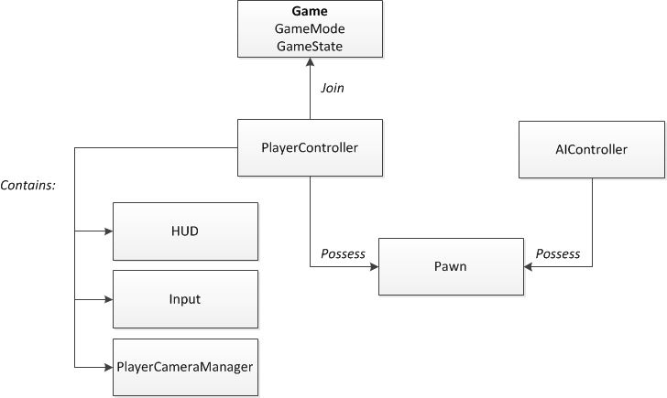
Game Framework Flowchart
Notes:
And here is a flow chart for the game framework classes.
The only class we have not discussed is the PlayerCameraManager.
It is part of the PlayerController and controls the movement of the player’s camera.

Slide 19
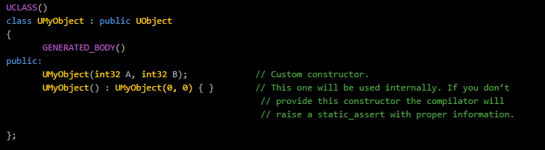
What’s New?
UObject Improvements
Custom constructors
Notes:
We continue to make improvements to Slate.
We are currently putting a lot of effort into improving compilation times and breaking out the many available widgets into to separate modules.
Of course, we have also released Unreal Motion Graphics, which is a user interface editor built on top of Slate.
UMG exposes powerful Slate features, such as 2D transformation and Blueprint scripting in designer friendly ways.

Slide 20
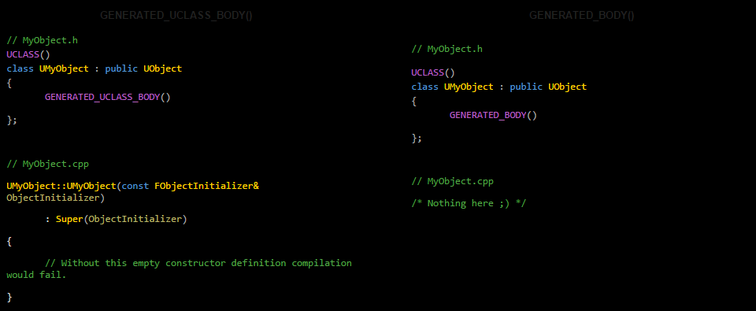
What’s New?
Notes:
We continue to make improvements to Slate.
We are currently putting a lot of effort into improving compilation times and breaking out the many available widgets into to separate modules.
Of course, we have also released Unreal Motion Graphics, which is a user interface editor built on top of Slate.
UMG exposes powerful Slate features, such as 2D transformation and Blueprint scripting in designer friendly ways.

Slide 21
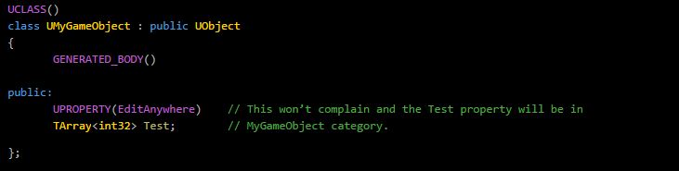
What’s New?
UObject Improvements
Custom constructors
Property categories no longer required
Notes:
We continue to make improvements to Slate.
We are currently putting a lot of effort into improving compilation times and breaking out the many available widgets into to separate modules.
Of course, we have also released Unreal Motion Graphics, which is a user interface editor built on top of Slate.
UMG exposes powerful Slate features, such as 2D transformation and Blueprint scripting in designer friendly ways.

Slide 22
What’s New in 4.6?
UObject Improvements
Custom constructors
Property categories no longer required
Hot Reload now supports adding/removing Properties & Ufunctions
Compiling from VS now automatically hot-reloads DLL in Editor
Framework Improvements
Include dependencies reduced
Include-What-You-Use ™
→ Faster compile times!
Notes:
We continue to make improvements to Slate.
We are currently putting a lot of effort into improving compilation times and breaking out the many available widgets into to separate modules.
Of course, we have also released Unreal Motion Graphics, which is a user interface editor built on top of Slate.
UMG exposes powerful Slate features, such as 2D transformation and Blueprint scripting in designer friendly ways.

Slide 23

Questions?
Documentation, Tutorials and Help at:
AnswerHub:
Engine Documentation:
Official Forums:
Community Wiki:
YouTube Videos:
Community IRC:
Unreal Engine 4 Roadmap
lmgtfy.com/?q=Unreal+engine+Trello+
http://answers.unrealengine.com
http://docs.unrealengine.com
http://forums.unrealengine.com
http://wiki.unrealengine.com
http://www.youtube.com/user/UnrealDevelopmentKit
#unrealengine on FreeNode
Notes:
Make sure to check out our extensive documentation on the internet!

