Slide 1
Extensibility in UE4
Customizing Your Games and the Editor
Gerke Max Preussner
max.preussner@epicgames.com
Notes:
Prepared and presented by Gerke Max Preussner for East Coast MiniDevCon 2014, November 12-13th
Email max.preussner@epicgames.com in case of comments, questions or suggestions or visit our AnswerHub at http://answers.unrealengine.com

Slide 2

Why Do We Want Extensibility?
Custom Requirements
Features that are too specific to be included in UE4
Features that UE4 does not provide out of the box
Third Party Technologies
Features owned and maintained by other providers
Scaleform, SpeedTree, CoherentUI, etc.
Flexibility & Maintainability
More modular code base
Easier prototyping of new features
Notes:
So, why do we want extensibility in the first place?
Unreal Engine 4 is an extremely powerful toolset for game developers that ships with many features out of the box.
However, many developers have special requirements that may require custom solutions.
We also want to allow other companies to integrate their own specialized tools into our Engine.

Slide 3
How To Extend The Engine
General
Games
Editor
Plug-ins
UE3: Engine Code Changes
Only accessible to licensees
Required deep understanding of code base
Merging Engine updates was tedious
UE4: Extensibility APIs
Modules, plug-ins, C++ interfaces
Native code accessible to everyone
Also supports non-programmers
Notes:
In Unreal Engine 3 and earlier, licensees had to change the Engine code directly in their own code branch.
Of course, that brought all kinds of problems with it, and UDK users could not make changes at all.
In Unreal Engine 4 we have a number of extensibility APIs.
They are still pretty new, but already work and are continuously being improved.

Slide 4

How To Extend The Engine
General
Games
Editor
Plug-ins
Blueprint Construction Scripts
Blueprints as macros to create & configure game objects
Activated when an object is created in Editor or game
Check out our excellent tutorials on YouTube!
Notes:
When it comes to games, Blueprint Construction Scripts are a great way for procedurally creating and configuring game objects.
This is quite a large topic, and if you join our Blueprint related talks today, you already know how they work and what they can do.
Otherwise, check out our tutorials on YouTube!

Slide 5
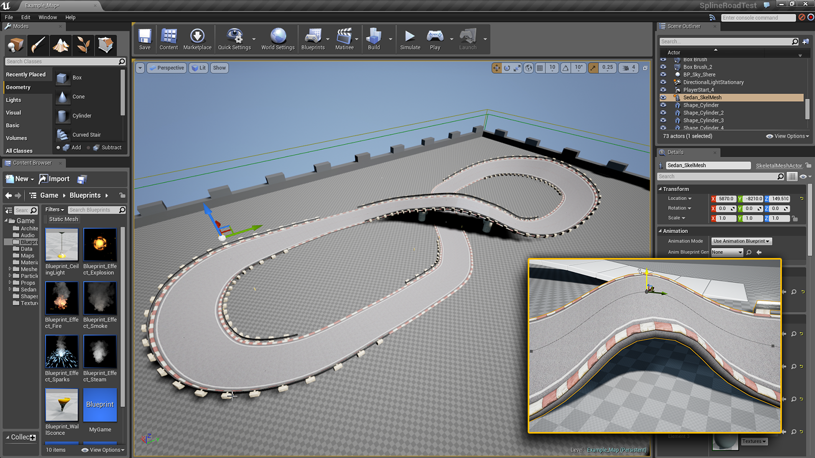
Notes:
Here you can see a screenshot of a spline based road editing tool that was built entirely using Blueprint Construction Scripts by one of our technical artists.

Slide 6
How To Extend The Engine
General
Games
Editor
Plug-ins
Details View Customization
Change the appearance of your types in the Details panel
Customize per class, or per property
Inject, modify, replace, or remove property entries
Menu Extenders
Inject your own options into the Editor’s main menus
Tab Manager
Register your own UI tabs
Allows for adding entirely new tools and features
Notes:
The Editor provides various APIs to add your own features and modify existing ones.
The most frequently used ones are Details View Customization, Menu Extenders and the Tab Manager.
Unfortunately, I don’t have the time today to go into programming details.
Please take a look at the various examples in our code base!

Slide 7
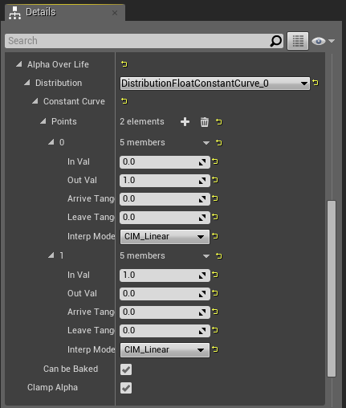
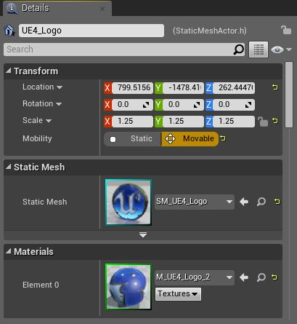
Default Appearance
Detail Customizations
Notes:
Here is an example of Detail Customizations, which are used heavily in Unreal Editor.
The Details Panel will generate a default appearance for all properties, but often those are not user friendly.
With Detail Customization you can completely override how each property will be shown to the user.

Slide 8

How To Extend The Engine
General
Games
Editor
Plug-ins
Blutilities
Blueprints for the Editor!
No C++ programming required
Can fire off events that effect the Editor
Currently experimental, but already working
Notes:
The Editor can also be extended with Blueprints, which do not require any C++ programming.
With the so called Blutilities you can add entire new features to the Editor.
Our technical artists have already built some great tools with it, and there will be more to come.

Slide 9
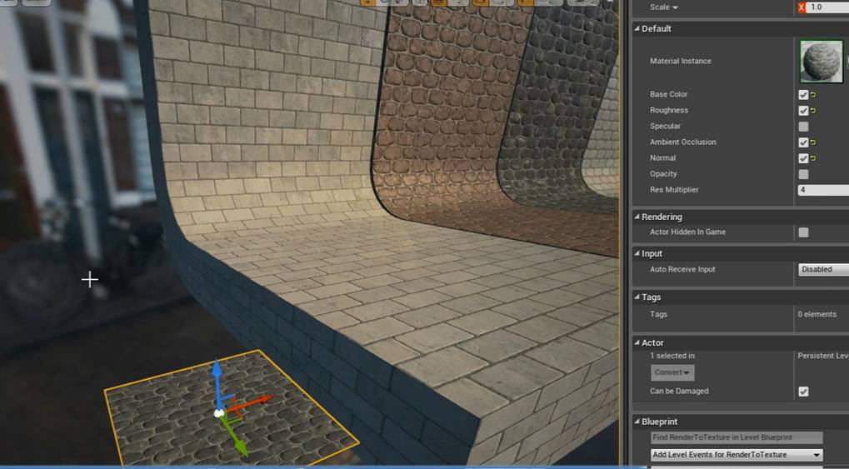
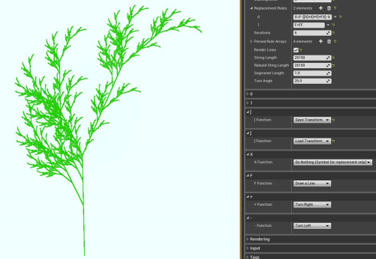
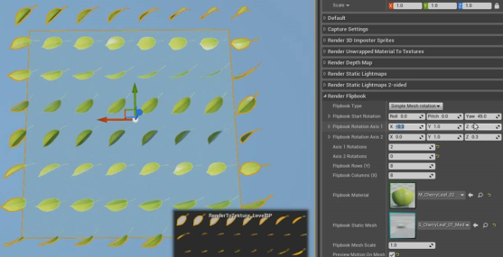
Procedural Textures, L-Systems, Flipbooks
Notes:
Here are some examples of tools that were built entirely using Editor Blueprints.

Slide 10

How To Extend The Engine
General
Games
Editor
Plug-ins
Overview
Extend the Engine, the Editor, or both
Are completely self contained
Can be enabled and disabled per project
Everything should be a plug-in!
Examples
BlankPlugin, UObjectPlugin – Use these to start coding
Perforce & Subversion support for the Editor
Oculus Rift support
Movie players, Twitch Live Streaming, Slate Remote
And many more!
Notes:
Plug-ins are the most powerful way to extend the Engine.
They are completely self contained packages of code and/or content that can be enabled on a per project basis.
The Engine ships with a number of plug-ins, including some templates that you can use as a starting point.
Our Editor uses more and more plug-ins to implement its features, and ideally nearly everything would be a plug-in at some point, but we’re not quite there yet.

Slide 11
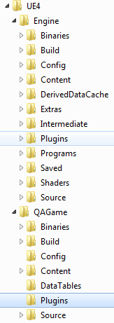
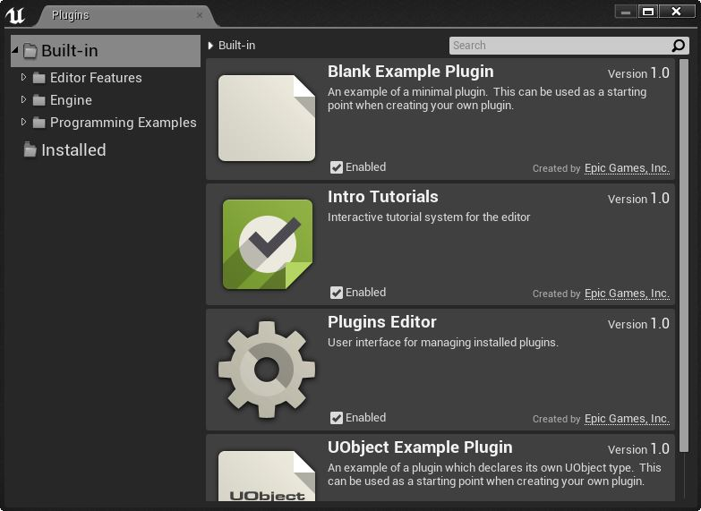
Notes:
Plugins can be located inside the Engine directory or inside your game project’s directory.
Engine plug-ins will be shared between the Editor and all your projects.
Project plug-ins only apply to the particular project.
The Plugin Manager in the Editor allows users to see which plug-ins are currently installed.

Slide 12
How To Extend The Engine
General
Games
Editor
Plug-ins
All Plug-ins
Will be loaded automatically on startup (if enabled)
Most not be dependencies of the Engine or other plug-ins
Plug-ins with Code
Have their own ‘Source’, ‘Binaries’, ‘Intermediates’ folders
Can have one or more code modules
May declare new UObject and UStruct types
Seldom have Public header files in modules
Plug-ins with Content
Have their own ‘Content’ folder
Configuration files (INIs) not supported yet
Notes:
Plug-ins can have code or content or both.
They will be loaded automatically by the Engine, if enabled.
Content plug-ins are still work in progress and require some special care.
Please visit our online documentation to learn more about the various plug-ins types.

Slide 13
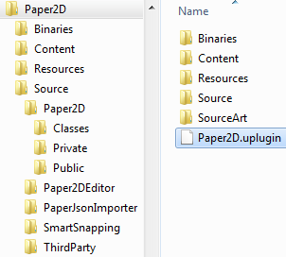
How To Extend The Engine
General
Games
Editor
Plug-ins
Descriptor Files (.uplugin)
{
"FileVersion" : 3,
"FriendlyName" : "Paper2D",
"Version" : 1,
"VersionName" : "1.0",
"CreatedBy" : "Epic Games, Inc.",
"CreatedByURL" : "http://epicgames.com",
"EngineVersion" : "4.2.0",
"Description" : "[EARLY ACCESS PREVIEW] Paper2D.",
"Category" : "2D.Helpers",
"EnabledByDefault" : true,
"Modules" :
[
// module definitions omitted
],
"CanContainContent" : true
}
Notes:
All plug-ins require a descriptor file to be present in their root directory.
This file contains meta data that is used by the Engine and the Editor for managing and loading the plug-in.
The example shown here shows the descriptor file of the Paper2D plug-in, which consists of multiple modules.
Each module can be configured independently, but I have omitted the details to keep things readable.

Slide 14
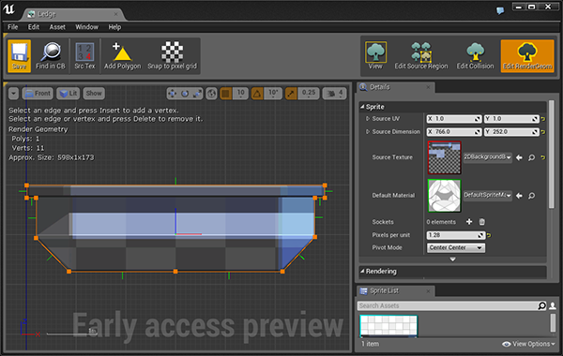
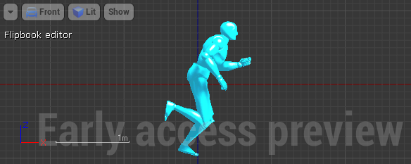
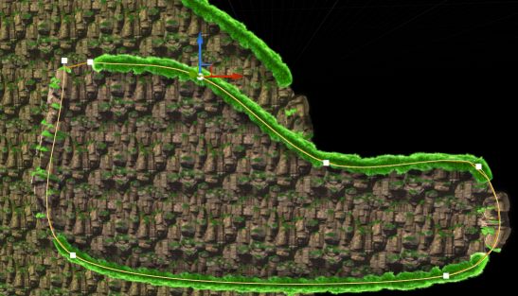
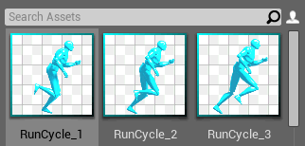
Notes:
Paper2D is actually a completely new Editor tool that has been implemented entirely as a plug-in!
It includes complex features, such as 2D spline & collision editing, custom view ports, and flipbook animation.

Slide 15
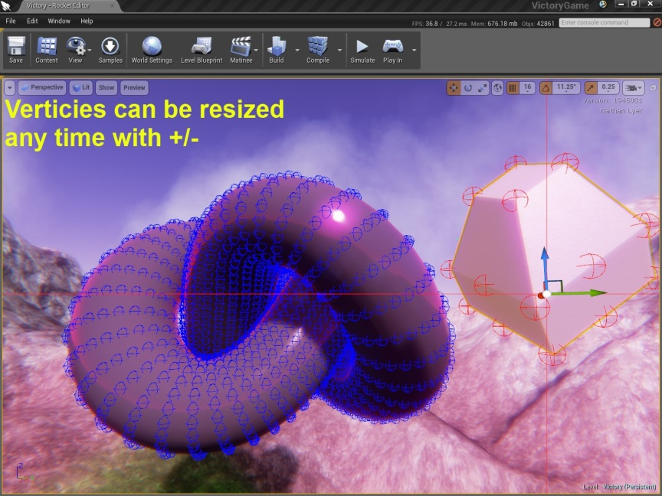

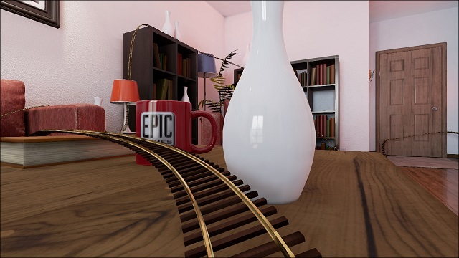
Vertex Snapping, Ocean Surface, Rollercoaster
More on the Wiki!
Notes:
We are also starting to see a number of plug-ins developed by the community.
Check out the Community Wiki for examples and tutorials.

Slide 16
Demo
Building a C++ plug-in in Visual Studio…
Notes:
[Widget Reflector Demo]

Slide 17

Questions?
Documentation, Tutorials and Help at:
AnswerHub:
Engine Documentation:
Official Forums:
Community Wiki:
YouTube Videos:
Community IRC:
Unreal Engine 4 Roadmap
lmgtfy.com/?q=Unreal+engine+Trello+
http://answers.unrealengine.com
http://docs.unrealengine.com
http://forums.unrealengine.com
http://wiki.unrealengine.com
http://www.youtube.com/user/UnrealDevelopmentKit
#unrealengine on FreeNode
Notes:
Make sure to check out our extensive documentation on the internet!

