Slide 1
Engine Overview
A Programmer’s Glimpse at UE4
Gerke Max Preussner
max.preussner@epicgames.com
Notes:
Prepared and presented by Gerke Max Preussner for East Coast MiniDevCon 2014, November 12-13th
Email max.preussner@epicgames.com in case of comments, questions or suggestions or visit our AnswerHub at http://answers.unrealengine.com

Slide 2

The Big Picture
Overview
Directories
Configuration
Modules
Projects
What’s Next?
This Is Not Your Grandma’s Engine
UE4 is pretty hot… but also huge!
5000+ directories, 40,000+ files
Bazillions of lines of code
Hundreds of modules
Dozens of tools, thousands of features
Centuries of man years
How To Master All This?
Start with toes, work your way up
Most code & content you’ll never touch
Nobody knows everything about UE4
But you’ll see, it’s really quite easy!
Notes:
Unreal Engine has been developed over a period of over 20 years and contains code and content from hundreds of developers.
The result is an unprecedented feature set for game development, but also a lot of things to learn.
Despite the large number of components and concepts, you should find it relatively easy to get started.
We have put a lot of effort into hierarchically organizing everything, so that the Engine as a whole is really just a big collection of simple parts.

Slide 3
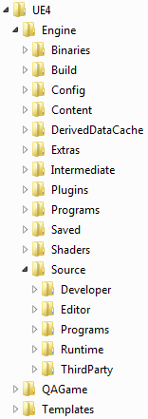
The Big Picture
Overview
Directories
Configuration
Modules
Projects
What’s Next?
Root Directory
/Engine – All code, content & configuration for the Engine
/MyProject – All files for the game project ‘MyProject’
/Templates – Templates for creating new projects
Inside the /Engine and /MyProject Directories
/Binaries – Executables & DLLs for the Engine
/Build – Files needed for building the Engine
/Config – Configuration files
/Content – Shared Engine content
/DerivedDataCache – Cached content data files (Engine only)
/Intermediate – Temporary build products (Engine only)
/Plugins – Shared and project specific plug-ins
/Saved – Autosaves, local configs, screenshots, etc.
/Source – Source code for all the things!
Notes:
The very first things you will encounter after downloading Unreal Engine 4 are the various directories on your hard drive.
Most of the files are located within the Engine directory, which contains everything needed to make and run games.
Over time, you will add your own directories, one for each project you are creating.

Slide 4
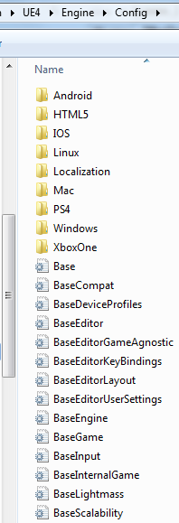
The Big Picture
Overview
Directories
Configuration
Modules
Projects
What’s Next?
INI Files
Hold class default properties
Will be loaded into CDOs on startup
Organized in a hierarchy
Higher INIs override lower ones
Organized in sections
Key-value pairs within sections
Important ones exposed in Editor UI
Low-level access with FConfig
Notes:
After looking at a few sample projects and perhaps creating your own first project, you may wonder how the Engine knows what to load and what to do.
The answer to this are configuration files – we call them INIs.
Many systems, such as the Engine, the Editor and games have their own so called INI file stack.

Slide 5
The Big Picture
Overview
Directories
Configuration
Modules
Projects
What’s Next?
INI Files
Hold class default properties
Will be loaded into CDOs on startup
Organized in a hierarchy
Higher INIs override lower ones
Organized in sections
Key-value pairs within sections
Important ones exposed in Editor UI
Low-level access with FConfig
XXX.ini
DefaultXXX.ini
BaseXXX.ini
Class Constructor
Notes:
There is not just one INI file, but multiple ones that are stacked hierarchically.

Slide 6
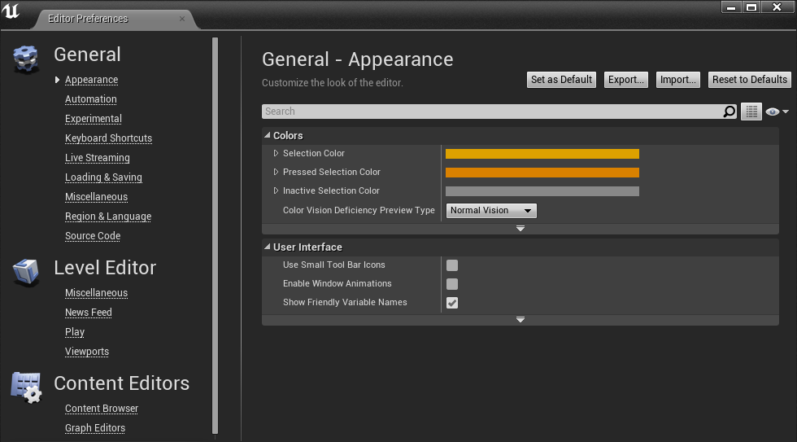
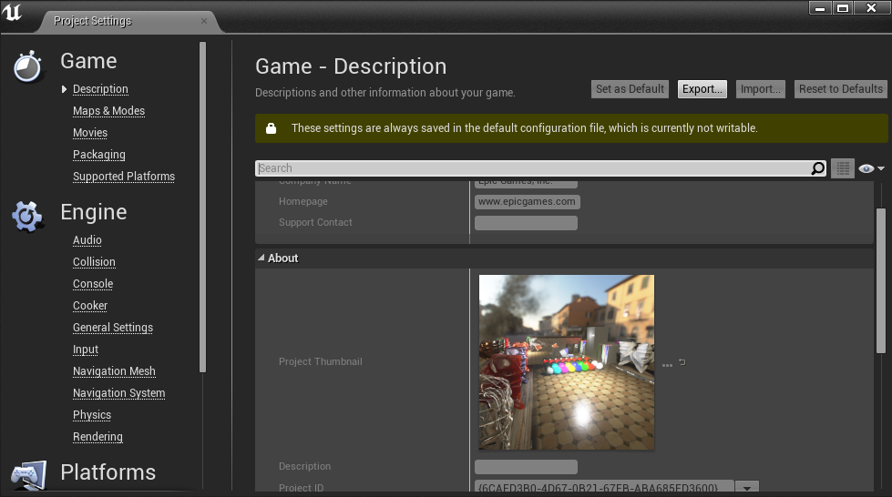
Editor & Project Settings
Notes:
In previous versions of Unreal Engine, users had to modify INI files quite frequently.
This was tedious and error prone.
In Unreal Engine 4 we are making a big push to expose all the important settings directly in the Editor.
We hope that, in the future, users will no longer have to edit INI files directly.

Slide 7
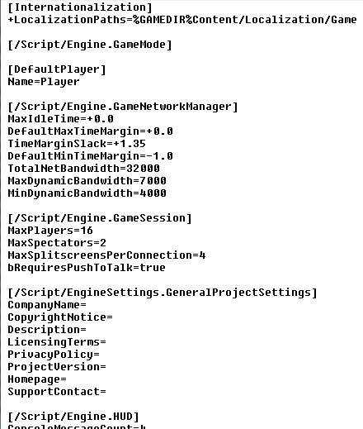
Sections for UObjects
[/Script/ModuleName.ClassName]
Sections for Custom Settings
[SectionName]
Supported Value Types
Numeric values, strings, enums
Structured data
Static and dynamic arrays
Automatic serialization for UObject properties
Notes:
For some very advanced settings you may still have to edit the INI files directly.
It cannot hurt to familiarize yourself with the syntax.
Here you can see a portion of the BaseGame.ini file.
The different types of sections and key-value pairs are easily recognized.

Slide 8
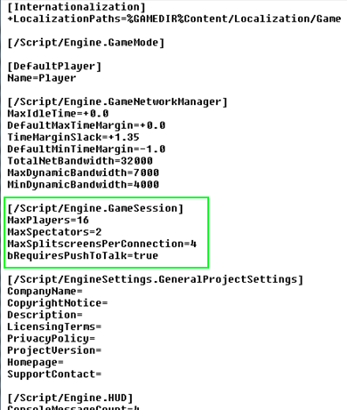
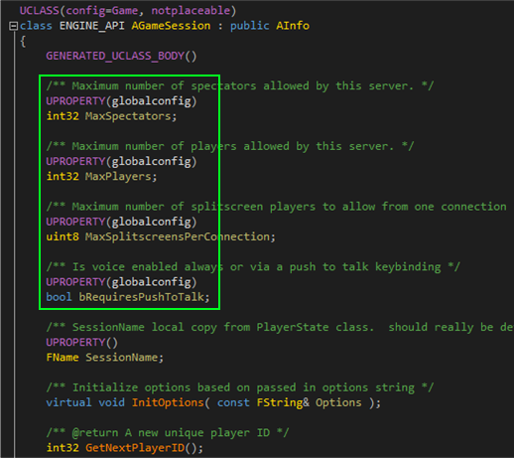
Notes:
Take a look at the GameSession class in this example.
Note that the C++ declaration of the class (right picture) is marked up with special attribute macros.
These macros cause our build tool to generate magic glue code that will add INI file support to the corresponding properties.
These properties can now be assigned in the INI file and will be automatically initialized when an instance of this object is created.

Slide 9

The Big Picture
Overview
Directories
Configuration
Modules
Projects
What’s Next?
Modularity Promotes
Reusability
Extensibility
Maintainability
Decoupling
Efficiency
Monolithic builds are still possible though!
Notes:
In previous versions of Unreal Engine all code was split into a small number of DLLs.
Each DLL had a large number of responsibilities, which lead to a lot of very tightly coupled code that was difficult to maintain and extend.
For Unreal Engine 4 we have rewritten large parts of the code base from scratch and reorganized it into hundreds of modules, each of which has one particular purpose.
Modules are still compiled into DLLs, but they can also still be compiled into one large monolithic binary.
The important point is that the code base is now much more organized and easier to use.

Slide 10
The Big Picture
Overview
Directories
Configuration
Modules
Projects
What’s Next?
Module Types
Developer – Used by Editor & Programs, not Games
Editor – Used by Unreal Editor only
Runtime – Used by Editor, Games & Programs
ThirdParty – External code from other companies
Plugins – Extensions for Editor, Games, or both
Programs – Standalone applications & tools
Module Dependency Rules
Runtime modules must not have dependencies to Editor or Developer modules
Plug-in modules must not have dependencies to other plug-ins
Notes:
We split our modules into various categories.
Modules that are used by the Engine can be found in the Runtime directory.
Modules that are used to build the Editor can be found in the Editor directory.
We also have some standalone programs, which share their modules with the Editor.
Those modules are located in the Developer directory.
One important convention to remember is that Runtime modules must not have any dependencies to Developer or Editor modules.

Slide 11
The Big Picture
Overview
Directories
Configuration
Modules
Projects
What’s Next?
Module Type | UnrealEd | App | Game
Runtime | √ | √ | √
ThirdParty | √ | √ | √
Plugins | √ | √ | √
Developer | √ | √ | X
Editor | √ | X | X
Module usage across different types of applications

Slide 12

The Big Picture
Overview
Directories
Configuration
Modules
Projects
What’s Next?
Important Modules for Beginners
Core – Fundamental core types & functions
CoreUObject – Implements the UObject sub-system
Engine – Game classes & engine framework
OnlineSubsystem – Online & social networking features
Slate – Widget library & high-level UI features
Notes:
Like I said, there are now hundreds of modules in the code base, but you only need to know a few of them.
When you first begin programming with Unreal Engine, you will frequently use features from Core, CoreUObject, Engine and Slate.
Nearly all other modules in the code base are built on top of one or more of these.

Slide 13

The Big Picture
Overview
Directories
Configuration
Modules
Projects
What’s Next?
Interesting Modules for Advanced Programmers
DesktopPlatform – Useful APIs for Windows, Mac & Linux
DetailCustomizations – Editor’s Details panel customizations
Launch – Main loop classes & functions
Messaging – Message passing sub-system
Sockets – Network socket implementations
Settings – Editor & Project Settings API
SlateCore – Fundamental UI functionality
TargetPlatform – Platform abstraction layer
UMG – Unreal Motion Graphics implementation
UnrealEd – Unreal Editor main frame & features
Notes:
Once you are more familiar with programming games and tools for Unreal Engine, you may also be interested in other more advanced modules.
Most of the remaining modules in the code base implement features for Unreal Editor.
You can use them as a learning resource for implementing your own plug-ins and applications.

Slide 14
The Big Picture
Overview
Directories
Configuration
Modules
Projects
What’s Next?
Interesting Modules for Cool Features
Analytics – Collects usage statistics from Editor & games
AssetRegistry – Database for assets in Unreal Editor
GameLiveStreaming – Twitch Streaming
HeadMountedDisplay – HMD Support API (Oculus, etc.)
JsonUtilities & XmlParser – Handle Json & XML files
SourceControl – API for custom source control providers
Notes:
There are also several modules that will make it easier for you to add cool new features to the Editor or your game.
We recently added the GameLiveStreaming module, which allows your users to stream their game play to Twitch.
There is also a module for 3D Head Mounted Display support – the Oculus plug-in uses it to add Oculus support to the Engine.
There are also various utility modules, such as Json and XML helpers.

Slide 15
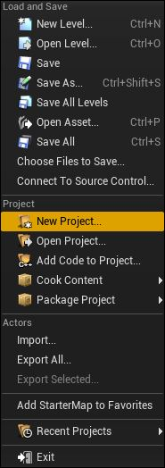
The Big Picture
Overview
Directories
Configuration
Modules
Projects
What’s Next?
Your Game Projects can…
Use Blueprints, C++ Code or both
Contain any number of modules & plug-ins
Be moved around and shared with others
Project Templates to Get You Started
Blank (with or without sample content)
First Person Shooter
Side scroller, top-down & puzzle games
Flying & driving games
They all come in Blueprint and C++ flavors
More to come, and make your own!
Notes:
All these modules are used in the Engine, the Editor and our tools.
However, you will actually spend most of your time in your own projects.
Projects are really easy to create in Unreal Engine 4.
We provide a number of both Blueprint and C++ project samples for various types of games.
More templates will be added over time, and you can even add your own.

Slide 16
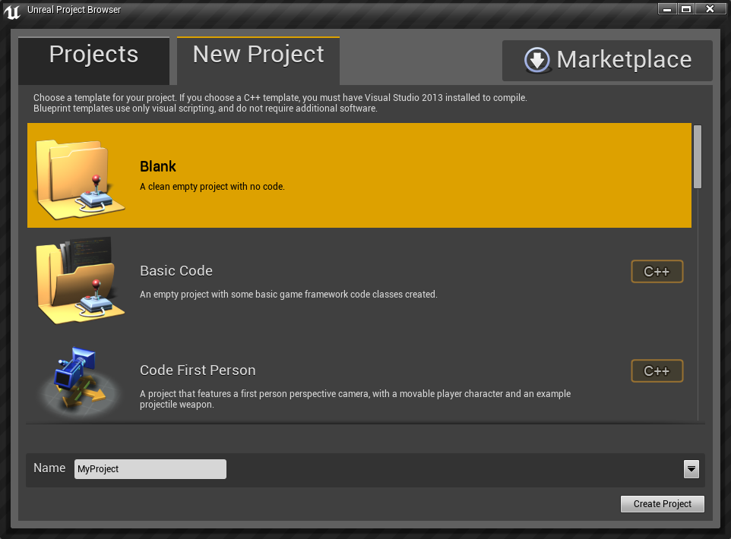
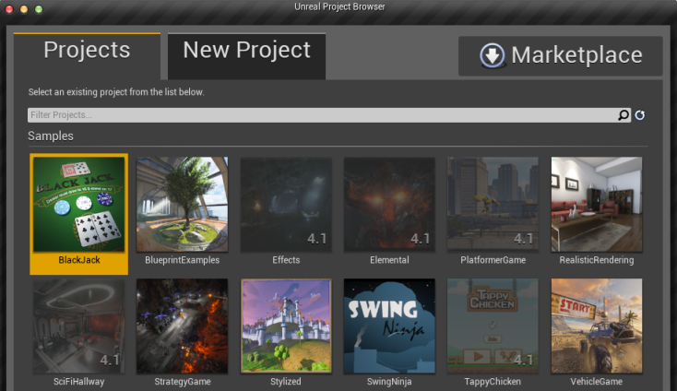
Project Templates & Samples
Notes:
Here you can see the project template browser and the sample project browser.

Slide 17
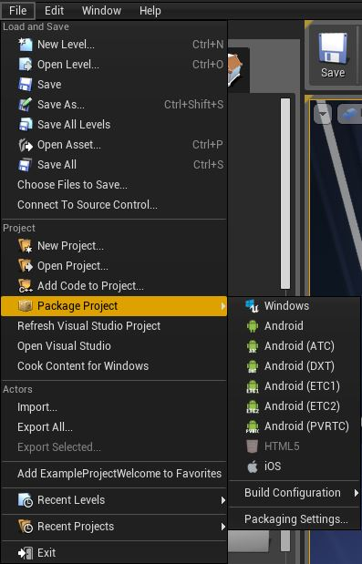
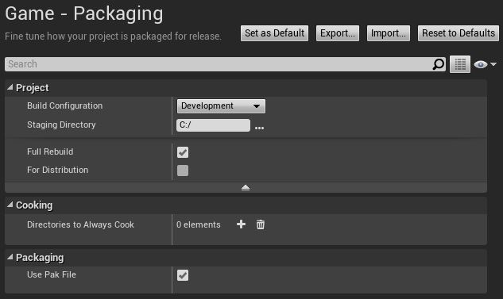
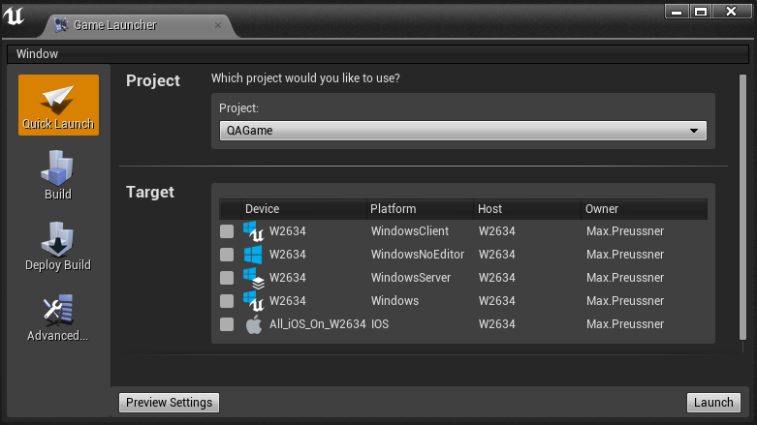
Project Packaging & Deployment
Notes:
When your project is ready for testing, you can cook, package and deploy it.
Cooking is the process of optimizing your game’s content for the desired target platforms.
Packaging will arrange all content files and binaries in a way that is best for the target device, usually a .pak file.
Deployment is the process of getting your packaged files onto the device.
Cooking and packaging each time is very time consuming.
We recommend that you use the Quick Launch feature instead, which utilizes Cook-On-The-Fly.

Slide 18

Y U No Use C++11??!?!
Overview
Directories
Configuration
Modules
Projects
What’s Next?
Actually, we do
override, final, nullptr keywords
auto (automatic type deduction)
range based for-loops
Lambdas and anonymous functions
Strongly typed enumerations
Move semantics
What about the rest?
XboxOne SDK is still on VS2012
Notes:
UE4 recently started to use C++11 language features that are well supported on all platforms that the Engine runs on.
Most notably, we are gradually replacing our OVERRIDE, FINAL and NULL macros.
For the time being, you will still see both the old macros and the new keywords being used in parallel.
We are also in the process of replacing static local functions with lambdas, and namespaced enums with enum classes.
We can’t use all of the modern language features yet, because the XboxOne SDK still requires Visual Studio 2012.

Slide 19
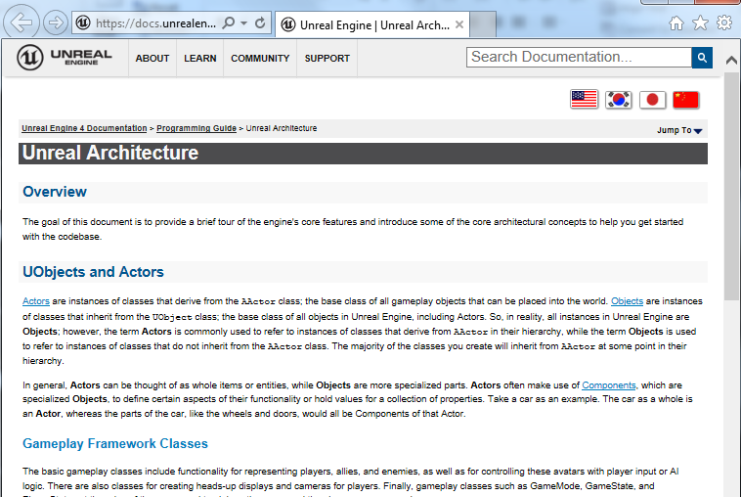

Overview
Directories
Configuration
Modules
Projects
What’s Next?
Notes:
Of course, this short presentation is not even remotely enough to introduce you to all the components of the Engine.
We have prepared a number of other talks for today that will provide more detail on various topics.

Slide 20

Questions?
Documentation, Tutorials and Help at:
AnswerHub:
Engine Documentation:
Official Forums:
Community Wiki:
YouTube Videos:
Community IRC:
Unreal Engine 4 Roadmap
lmgtfy.com/?q=Unreal+engine+Trello+
http://answers.unrealengine.com
http://docs.unrealengine.com
http://forums.unrealengine.com
http://wiki.unrealengine.com
http://www.youtube.com/user/UnrealDevelopmentKit
#unrealengine on FreeNode
Notes:
Make sure to check out our extensive documentation on the internet!

