Slide 1
Build Automation
Epic’s Build Tools & Infrastructure
Gerke Max Preussner
max.preussner@epicgames.com
Notes:
Prepared and presented by Gerke Max Preussner for West Coast MiniDevCon 2014, July 21-24th
Email max.preussner@epicgames.com in case of comments, questions or suggestions or visit our AnswerHub at http://answers.unrealengine.com
Hi, my name is Max, and I would like to tell you a little bit about our build tools and how we use them for automating our build processes at Epic Games.

Slide 2

Sorry, we ran out of cats for this presentation
Notes:
But first I want to apologize for the lack of cats in this presentation.
After doing all the previous presentations, we simply ran out of cats.

Slide 3
Build Tools
UHT
UBT
UAT
Unreal Header Tool (UHT)
Written in C++
Parses all C++ headers containing UClasses
Generates glue code for all Unreal classes & functions
Generated files stored in Intermediates directory
Notes:
The three main tools you will come across are Unreal Header Tool, Unreal Build Tool, and Unreal Automation Tool.
If you visited one of our programming talks earlier today, you will already know that mark up our C++ classes and functions with special macros.
UHT is the tool that parses your header files and converts these macros into magic glue code to enable powerful features like Run-time Reflection and Network Replication.
All code generated by UHT is stored in the Intermediates directory, and you will likely never have to look at it, ever.

Slide 4
Build Tools
UHT
UBT
UAT
Unreal Build Tool (UBT)
Written in C# (may convert to C++ in the future)
Scans solution directory for modules and plug-ins
Determines all modules that need to be rebuilt
Invokes UHT to parse C++ headers
Creates compiler & linker options from .Build.cs & .Target.cs
Executes platform specific compilers (VisualStudio, LLVM)
Other UBT Features
Project file generation (GenerateProjectFiles.bat)
Remote Compilation (iOS, MacOS)
Notes:
Unreal Build Tool is our custom solution to compiling and building the Engine and your projects.
When you compile in Visual Studio or XCode, we don’t actually use either one to perform the compilation, but everything goes through UBT instead.
UBT also contains the logic for generating your project and solution files when you run the GenerateProjectFiles.bat batch file.

Slide 5
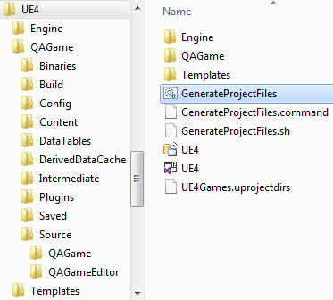
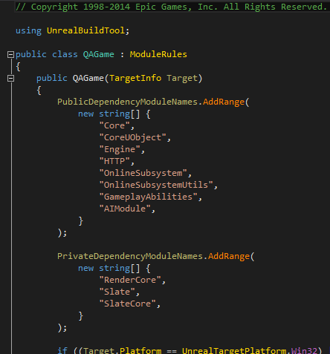
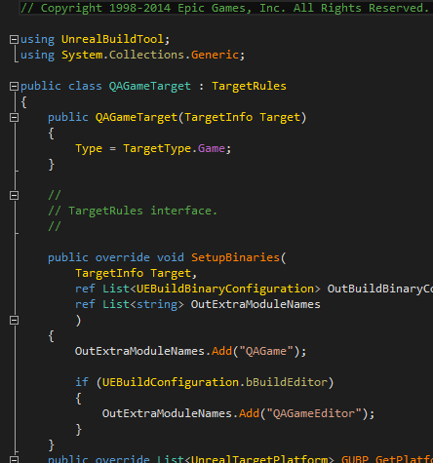
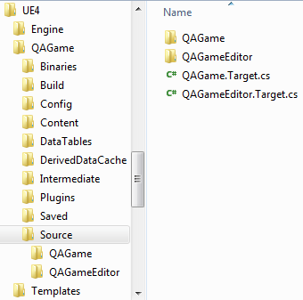
Build Rules
Notes:
UBT uses the special C# files *.Build.cs and *.Target.cs that you create inside your module directories to figure out what it needs to do.
Here you can see the build and target rules files for QAGame, a special game that our QA team uses for internal testing.

Slide 6

Dependency Graph
Notes:
Another little known feature of UBT is the ability to generate dependency graph data that can be visualized.
Here is a screenshot of a JavaScript based visualizer that shows a section of our code base.

Slide 7
Build Tools
UHT
UBT
UAT
Unreal Automation Tool (UAT)
Written in C# (may convert to C++ in the future)
Automates repetitive tasks through Automation Scripts
Build, cook, package, deploy and launch projects
Invokes UBT for compilation
Other UAT Scripts
Analyze and fix up game content files
Code surgery when updating to new Engine versions
Distributed compilation (XGE) & build system integration
Generate code documentation
Automated Testing of code and content
And many others – you can add your own scripts!
Notes:
Last but not least, we have Unreal Automation Tool.
Like UBT, it is currently written in C#, and you can think of it as batch files on steroids.
We use it for a wide range of tasks that we wish to automate, and you can easily add your own scripts, too.
The most frequently used automation tasks have to do with building, cooking, packaging, deploying and launching your projects.
UAT also performs a number of other common tasks, such as generating documentation and automated testing.

Slide 8
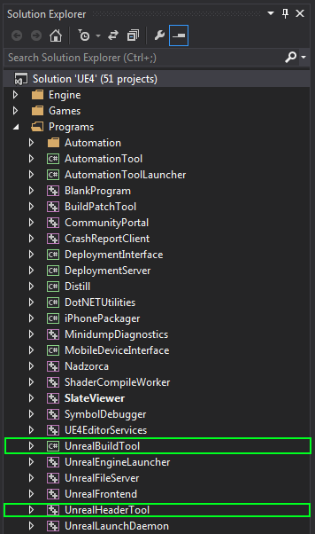
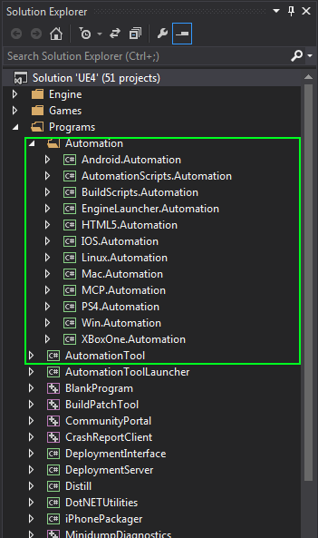
UBT, UHT, UAT Projects
Notes:
The full source code for all three tools is included with the Engine.
You can find it in the Engine’s “Programs” directory on GitHub.

Slide 9
Build Automation
SCC
CIS
Promotion
Testing
Source Code Control (SCC)
We use Perforce, but you don’t have to
Not just code, but also content and everything else
Also contains compiled binaries from build system (!)
Used to version many other things (Markting, QA, etc.)
GitHub Integration
Check-ins are pushed to GitHub Master in near real-time
Script for converting GitHub pull requests to P4 CLs
Notes:
At Epic we use these three tools to automate our daily production workflows.
For our internal version control system we use Perforce, but we also support Subversion out of the box.
Programmers in the community are working on plug-ins for other source code control systems, such as Git and Mercurial.
In case you wonder how the Engine files get from our Perforce to GitHub: we have scripts for automatically converting between the two.

Slide 10
Build Automation
SCC
CIS
Promotion
Testing
Continuous Integration System (CIS)
Verifies all check-ins of code and content
Grand Unified Build Process (GUBP)
Thousands of build tasks a day
Backend Software
Used custom build server for several years
Experimented with Jenkins, but not scalable enough
Now using Electric Commander
Complex workflows with hundreds of jobs and sub-tasks
Build Hardware
Virtualized farm of Windows and MacOS build servers
Notes:
Every single code or content check-in made to our Perforce server will be verified by our Continuous Integration System (CIS).
It consists of a farm of build servers that run special software for making and verifying distributed builds.
In the past we have created our own CIS software, but we recently switched to off-the-shelf products.
With thousands of daily build tasks for several games across up to ten different platforms, only Electric Commander was able to meet our needs.
We also experimented with open source systems, such as CruiseControl and Jenkins, which will likely be sufficient for small to medium sized studios.

Slide 11
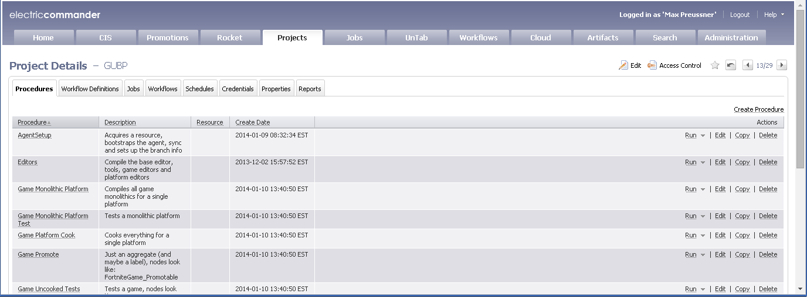
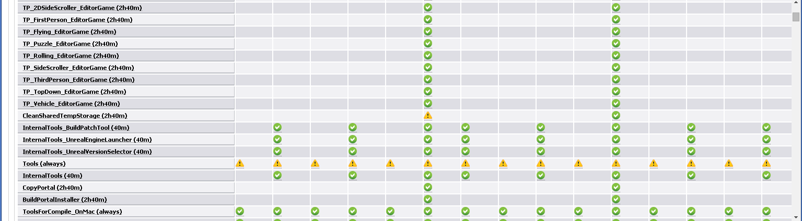
GUBP
Notes:
Our build engineers recently developed a special build process called the Grand Unified Build Process.
It intelligently minimizes the number of modules that have to be built for the various build configurations and build targets.
For most game studios a regular build script will suffice.

Slide 12

Build Automation
SCC
CIS
Promotion
Testing
Build Promotion
Selected successful CIS builds are tested by QA
Builds that pass QA will be promoted to stable
Selected stable builds become release candidates
Approved stable builds are released to public
Notes:
Some of the builds that pass CIS are then picked up by our QA team to search for bugs and other problems.
When a build is found to be stable enough for distribution, the QA team will mark it as ‘promoted’ in our build system.

Slide 13
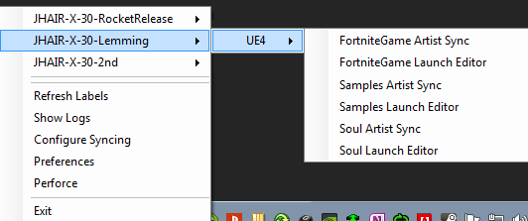
Build Automation
SCC
CIS
Promotion
Testing
UnrealSync
Tool for artists to fetch the latest promoted build
Aware of P4 branches and projects
Notifies user when new promoted build is available
Notes:
Promoted builds are made accessible to our artists through a small tool called UnrealSync.
UnrealSync runs in the system tray and notifies our artists when a new promoted build is available.
Artists can then use it to sync their branches to the latest promoted label.

Slide 14
Build Automation
SCC
CIS
Promotion
Testing
Automated Testing
Simple and complex tests
Unit tests for C++, content verification
Parallel testing on multiple platforms & devices
Can also run from command line (as a Commandlet)
Simple Tests
Single atomic test that can pass or fail
Unit tests for C++, feature tests for content
Examples: Play a map in PIE, verify text wrapping in Slate, etc.
Complex Tests
Run same test code on a number of inputs
Examples: Load all maps in the Editor, compile all Blueprints, etc.
Notes:
Our QA team has to perform a large number of very repetitive tests, especially during regression testing.
One common, time consuming and extremely boring task is to ensure that all maps still load without errors in the Editor.
Our Automation Test Framework can be used to automate these kinds of tasks.
We are also starting to embrace Test-Driven Development (TDD) with the help of C++ unit tests.
The Automation Test Framework can handle these as well.

Slide 15
// Example for a simple automation test that runs in a game
IMPLEMENT_SIMPLE_AUTOMATION_TEST(FSetResTest, "Windows.SetResolution", ATF_Game)
bool FSetResTest::RunTest( const FString& Parameters )
{
FString MapName = TEXT("AutomationTest");
FEngineAutomationTestUtilities::LoadMap(MapName);
int32 ResX = GSystemSettings.ResX;
int32 ResY = GSystemSettings.ResY;
FString RestoreResolutionString = FString::Printf(TEXT("setres %dx%d"), ResX, ResY);
ADD_LATENT_AUTOMATION_COMMAND(FEngineWaitLatentCommand(2.0f));
ADD_LATENT_AUTOMATION_COMMAND(FExecStringLatentCommand(TEXT("setres 640x480")));
ADD_LATENT_AUTOMATION_COMMAND(FEngineWaitLatentCommand(2.0f));
ADD_LATENT_AUTOMATION_COMMAND(FExecStringLatentCommand(RestoreResolutionString));
return true;
}
Simple Automation Test
Notes:
Here is a simple (and not very useful) automation test for setting and resetting the screen resolution.

Slide 16

Automation Test Demo
Notes:
It’s not a cat, it’s a dragon!
[demo of Automation Tests in the Editor’s Session Frontend UI]

Slide 17

Questions?
Documentation, Tutorials and Help at:
AnswerHub:
Engine Documentation:
Official Forums:
Community Wiki:
YouTube Videos:
Community IRC:
Unreal Engine 4 Roadmap
lmgtfy.com/?q=Unreal+engine+Trello+
http://answers.unrealengine.com
http://docs.unrealengine.com
http://forums.unrealengine.com
http://wiki.unrealengine.com
http://www.youtube.com/user/UnrealDevelopmentKit
#unrealengine on FreeNode

